Slide 1
Enhancing Family Engagement Module 2
Communicating Effectively

Slide 2
PaTTAN’s Mission
The mission of the Pennsylvania Training and Technical Assistance Network (PaTTAN) is to support the efforts and initiatives of the Bureau of Special Education, and to build the capacity of local educational agencies to serve students who receive special education services.
Notes:
This slide shows PaTTAN’s mission to support the efforts and initiatives of the Bureau of Special Education. We strive to build the capacity of those who serve students who receive special education services.
Authentic family engagement is a cornerstone of successful school-home partnerships. PaTTAN assists in the efforts of educational professionals and families of children with diverse needs to build strong relationships that lead to student achievement

Slide 3
PDE’s Commitment to Least Restrictive Environment (LRE)
Our goal for each child is to ensure Individualized Education Program (IEP) teams begin with the general education setting with the use of Supplementary Aids and Services before considering a more restrictive environment.
Notes:
The PA Bureau of Special Education (BSE) supports the Pennsylvania Department of Education’s (PDE) commitment to ensuring the Least Restrictive Environment (LRE). Families are an integral part of the Individualized Education Program (IEP) team.

Slide 4
Family Engagement
Family Engagement promotes equitable partnerships among schools, families and communities to actively promote student achievement through shared commitment, decision-making and responsibility.
#PAFamilyEngagement
Notes:
This is the definition of Family Engagement that we, at PaTTAN, use.
Also note that we have a Twitter hashtag, #PAFamilyEngagement. Please ‘like’ us!
The PaTTAN Family Engagement Initiative believes in:
Families and schools working together, because our students are worth it.
And we are: Bringing families, schools, and communities together.

Slide 5
Regulations and Implications for Practice
IDEA
ESSA
PA State Performance Plan (SPP)
Indicator 8
Danielson Framework
Component 4C - Communicating with Families
PA System for Principal Effectiveness
Component 4A – Maximizes Parent and Community Involvement and Outreach
Notes:
Here is an example of the necessity of family engagement within the law and standards for education.
The Individuals with Disabilities Education Act (IDEA) of 2004, PL 108-446, requires improving results for students with disabilities. IDEA also requires all states to develop a State Performance Plan, which includes 20 indicators that describes how the state will implement the Federal requirements and improve results for students with disabilities. Indicator 8 measures the percentage of parents, with a child receiving special education services, who report that schools facilitated parent involvement as a means of improving services and results for children with disabilities.
The Every Student Succeeds Act (ESSA) is a US law that governs K-12 public education policy. Pennsylvania designed its plan for Annual Meaningful Differentiation through a nationally-recognized stakeholder engagement effort that included educators, parents and families, and policy and community leaders. Pennsylvania’s accountability systems and school progress reporting will provide educators, parents and families, and other stakeholders with clear and meaningful reporting on both school and student group performance, as well as the ability to identify and act on opportunity gaps.
The Danielson Framework (Domain 4 – Professional Responsibilities, Component 4C) focuses on communication with families. In order for teachers to demonstrate competence in this area, proactive, frequent, appropriate, and two-way communication with families is paramount. Additionally, sharing information about instructional programs and student progress, so that the families can engage in their children’s learning processes, is vital.
Act 82 Principals/Assistant Principals (Domain 4 – Professional and Community Leadership, Component 4A) focuses on maximizing parent and community involvement and outreach. The school leader designs structures and processes, which result in parent and community engagement, support, and ownership for the school.

Slide 6
ESSA Parent Guide
Share with Your School Community!
Notes:
This guide, from the US Department of Education helps parents understand Every Student Succeeds Act (ESSA), which amended the Elementary and Secondary Education Act, a landmark Federal education law.
This free resource can be found when you click on the picture, or at https://tinyurl.com/essaparentguide

Slide 7
Core Beliefs of Family Engagement
All families have dreams for their children and want what is best for them.
All families have the capacity to support their children’s learning.
Families and school staff are equal partners
The responsibility for cultivating and sustaining partnerships among school, home and community rests primarily with school staff, especially school leaders.
Mapp, Carver & Lander, 2017
Notes:
Schools should be exemplars of a welcoming environment. In order to create a welcoming school community, administrators and educators within the school community must embrace several core beliefs of family engagement. First, they must recognize that all families have dreams for their children and want the best for them, even if those dreams may not be what the educators themselves might identify as important. They must also presume competence in each family’s ability to support learning in the home with the right scaffolding. Administrators and educators must also think of families as stakeholders and equal collaborative partners who vitally contribute to their children’s education.
Additionally, school staff must be willing to take on the onus of cultivating and sustaining relationships between home, school, and community. Administrators play a vital role in establishing a culture of welcoming and mutual respect.

Slide 8
Learning Outcomes
Discuss
Discuss the importance of building home-school partnerships through effective communication.
Review
Review the basic elements of communication
Examine
Examine various types of communication
Analyze
Analyze current home-school communication processes
Notes:
The learning outcomes presented on this slide give an overview of how this training will focus on the specific impact effective communication practices impact family involvement. Offering a variety of means of communication and being culturally aware can encourage and improve family participation.

Slide 9
Family Engagement and Communication
Notes:
This training will focus on building school, family and community connections through effective communication. The intent is to share what effective communication looks like and offer strategies to evaluate and improve your current communication practices.

Slide 10
Benefits of Effective Communication
Improved test scores
Improved grades
More positive student attitudes
Fewer special education referrals
Lower dropout rates
Less high-risk behavior
Higher staff morale
Enhanced relationships between school and community
Increased support for school initiatives and programs
Increased donations of materials and services
Improved parental opinion of and regard for the school
Notes:
When you look at the slide you get an idea of the impact that is made through family engagement work. The research behind actively engaging families is sound. A key ingredient for reaching families is effective communication.
Sharing these eleven benefits with staff and families is the first step to improving family engagement. Consider how you could provide this information to your families. What effective ways could be used to ensure families receive and understand this information?
It is our hope by the end of this PowerPoint you will have new insight and strategies to do just that.

Slide 11
Benefits Across Stakeholders
Teachers
Increased ability to elicit and understand family views on student programs and progress
Increased diversity and use of communication with families
Increased awareness of own ability to communicate clearly
Increased appreciation of parent network for communication
Families
Increased perception of school quality rating
Ability to support children academically
Ease of interactions and communications with school and teachers
Students
Awareness of own progress in subjects and skills
Knowledge of actions needed to maintain or improve grades
Awareness of own role as courier and communicator in partnerships
Teachers
Families
Students
Notes:
Consider the benefits to all the parties included. Looking over this list are there any others you can think of. We also have not listed the benefits to the community or community organizations. Effective communication across your community partners also improves engagement with them and families as well.

Slide 12
Home-School Communication
Home-school communication is among the most important factors in developing strong relationships between teachers and families.
~Epstein
Parents seek good communication skills in their children’s teachers, citing it as one of the most desirable characteristics a new teacher could have.
~McDermott & Rothenberg
Strong communication can also encourage higher and more realistic parental expectations.
~James, Jurich & Estes
The Research
Notes:
As noted in these quotes from family engagement researchers, several factors are important in home-school communication.
When schools connect with families using a variety of methods parents’ and students’ respond positively.
Finding a variety of ways to reach parents takes effort. Surveys, trial and error as well as sending the same information through multiple means of communication are just some of the examples that strengthen the home-school connection.

Slide 13
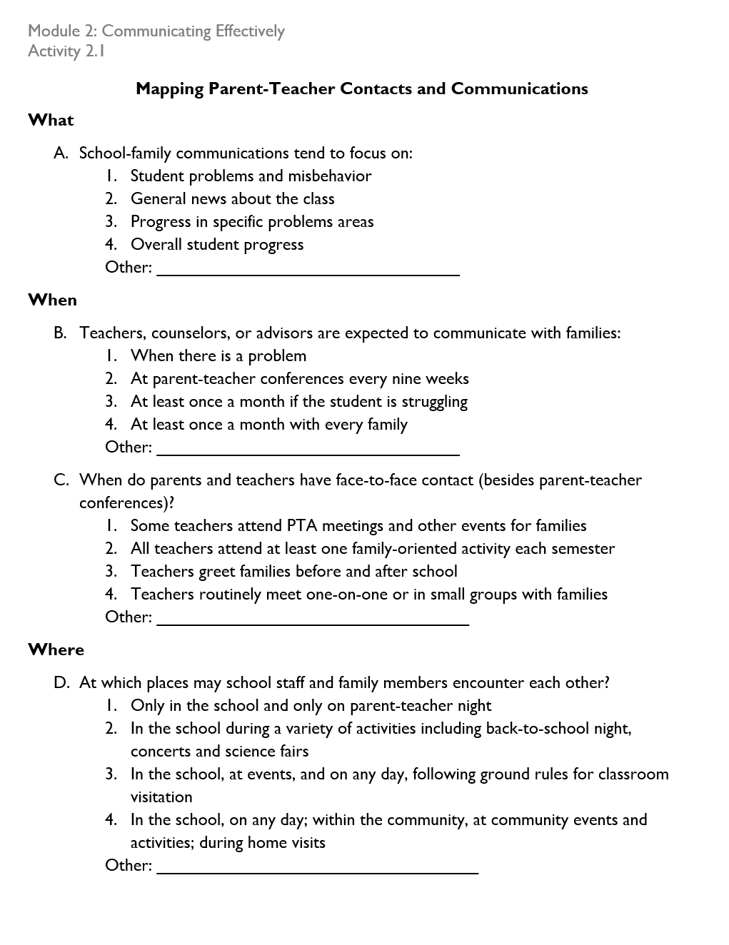
Contacts & Communication Considerations
Activity 2.1
Notes:
Examine your practices around communicating and contact with parents.
Using activity 2.1 you can look at your current practices and determine if you need to re-examine or re-structure your parent-teacher interactions.
Keep in mind positive, two-way, and open, are key words around communicating with parents and families.

Slide 14
Diversity in Communication

Slide 15
Elements of Diversity
Race
Language
Sexual Orientation
Occupation
Ethnicity
Socio-economic Status
Ability and Disability
Culture
Nationality
(Henderson, Mapp, Johnson, & Davies, 2007)
Notes:
Diversities impact how we communicate. We live in a diverse society. While certain differences, such as diversities in race and ethnicity, may be easy to see, other differences, such as those involving socio-economic status and sexual orientation may be less visible. This does not, however, mean that they do not impact the daily lives of our students and our interactions with those students. The best way for us to respond to these differences is by increasing our own self-awareness of our personal identities and understanding how our background has influenced who we are. Then we must recognize that the backgrounds of others are relevant and acceptable, and also shape who they are. Elements of race, language, sexual orientation, occupation, ethnicity, socio-economic status, ability and disability, and culture and nationality, can all have implications on how we communicate with each other.

Slide 16
Making Materials Accessible to All
Consider all potential communication barriers
Use headings
Use meaningful hyperlinks
All images have alternative text
Closed-captioning for videos
Use lists
Notes:
Ask participants to read over the points on this slide. Have them consider if these are practices they are already doing, need to implement, or need to collect input from families about.

Slide 17
Cross-Cultural Communication
Over one-third of students in Pre-K through grade 12 classrooms are from minority groups, and the families of an increasing number of students are immigrants, many with native languages other than English.
National Center for Education Statistics
Notes:
A large part of being prepared to partner with families is to embrace the cultural differences of the school community. Despite the statistics on this slide, many new teachers are unprepared to deal with the challenges of this diversity in their classrooms. (E. Trumbull, 2011).
People of various cultures communicate differently and in unique styles. If schools are to strengthen home-school relationships, they need to effectively use cross-cultural communication. A Chuukese parent in a study by Stoicovy and colleagues (2011) stated that “school is not communicating clearly to the home, so that may be one reason why the home is not participating in some of those expectations of functions that are held at the school” (p. 13).
According to Halgunseth, 2009, it is critical to translate important communications into the various languages represented in the school community, making families feel welcome in the school with signs in their language, and inviting role models from the various cultures into the classroom. Halgunseth goes on to say, ‘educators should listen to and provide families the opportunity to give feedback on their children’s progress in a manner that is culturally appropriate for them.’
Cross-cultural communication also involves being sensitive to cultural customs, and being careful as to how words are used. We must avoid conversations that imply that all people of an ethnic group are ‘all the same.’ Using language which promotes unity and common concern for the well being and academic and social achievement of the child bridges any gaps in communication and shows respect.
Increasing diversity in the student population intensifies the need for and the difficulties of establishing culturally sensitive and meaningful communication between teachers and families. Eberly, Joshi, & Konzal examined the opinions and practices of 21 early childhood and elementary school teachers through a multi-phase research design. They discovered that even when teachers claimed to recognize the importance of respecting cultural differences, they nonetheless displayed and acted upon preconceived cultural biases. It was surmised that most teachers would benefit from professional development programs that asked them to confront their own cultural biases.
In a focus group of 21 teachers…Participants said it was important to understand families’ practices and beliefs BUT simultaneously negatively judged specific beliefs and practices. Participants who valued diversity understood the importance of engaging families in two-way, non-judgmental dialogue in order to build relationships (Eberly, Joshi, & Konzal, 2007)

Slide 18
Tips for Effective Cross-Cultural Communication
Learn and maintain etiquette
Avoid slang, idioms, and double meanings
Practice active listening
Speak slowly
Keep it simple
Notes:
Many cultures have specific etiquette around the way they communicate. Before you meet, find out what specific etiquettes are valuable in the other person’s culture. For example in some cultures it may be disrespectful to use first names. Being unaware of this may result in inadvertently offending someone
Not even the most educated non-native English speaker will have a comprehensive understanding of English slang, idioms and sayings. They may understand the individual words you have said, but not the context or the meaning. As a result you could end up confusing them or at worst, offending them.
Modulating the pace of your speech will help you speak clearly and be better understood. Consider clear but concise sentences and make sure you give the other person time to digest what you are saying. However, be careful not to go too slow that it is misinterpreted as patronizing.
In a cross-cultural conversation you will make it easier for both of you by avoiding big words and speaking as simply as possible.
Active listening is a very effective strategy for improving cross cultural communication. By restating or summarizing what the other person said you will ensure that you have understood them correctly. You can also show you are listening by asking questions. This will help avoid missing any important information.

Slide 19
Additional Tips for Effective Cross-Cultural Communication
Take turns
Caution with humor
Ask one question at a time
Be respectful
Avoid closed-ended questions
Notes:
Make sure you allow the other person to respond, ask questions, and express themselves as well
In many cultures humor is considered disrespectful
Speak in a respectful and supportive manner. Acknowledge when they speak and show that you are there to support and encourage them
In some cultures, answering no means they are wrong and may be perceived as offensive
Letting the other person answer one question at a time will avoid confusion or making anyone feel overwhelmed

Slide 20
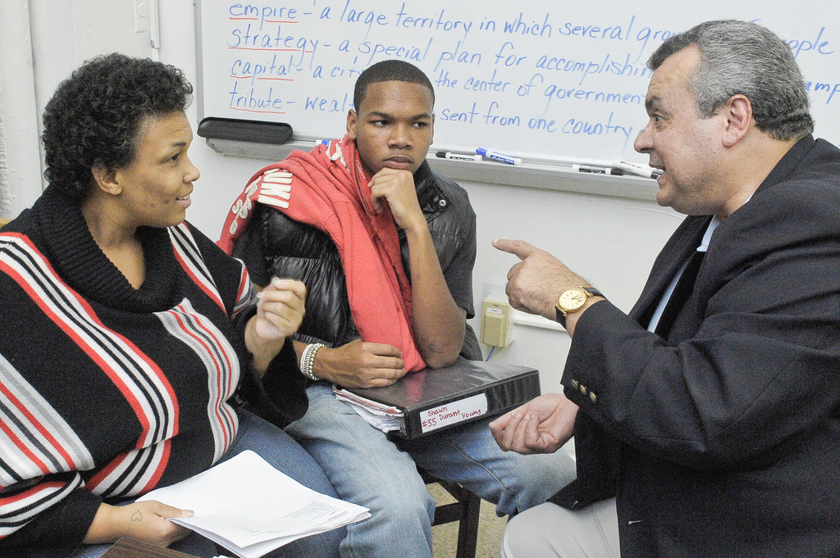
How could being unaware of differences in cross-cultural communication hinder social interactions between teachers and families?
Activity 2.2
Communication Differences
Notes:
People’s backgrounds affect the ways they communicate. Communication may be shaped by any of the elements of diversity – culture, language, socio-economic status, etc. Differences may exist in articulation (sound production), semantics (word choice), proximity (spacing), vocal intensity (loudness levels), and many other components, including non-verbal behaviors such as eye contact. To be more aware of the communication traits of others, we must first thoughtfully and insightfully reflect upon our own personal biases. We must also examine how communication differences impact us and how they may potentially influence others. Our families may not communicate as we do and that is all right. However, we must consider the following: How do we feel when communicating with someone with significantly different tendencies than ourselves? How do you think others with different communication tendencies feel when communicating with us? To review this topic further, please access Activity 2.3 “Partner Talk – Exploring Communication Differences.”
Refer to Activity 2.3: The purpose of this activity is to recognize the ways in which individuals might communicate differently based on their backgrounds and to discuss the impact that these differences may have on communications between educators and family members.
Debrief Activity 2.3: How did group members feel as they were communicating with individuals with different communication styles? Did this influence how they spoke and what they said? Were they able to adapt their communication style to better relate to their communicative partner?

Slide 21
Preparing for Communication

Slide 22
The Communication Process Framework
Identify the goal and reason for the communication
Consider the audience
Choose a communication approach
(Caspe, 2008)
Notes:
Engaging families through live (two-way) communication helps to keep parents well-informed, promote parent involvement, and build a partnership that promotes students’ educational success. Exactly what we are looking to do, right? However, how do we start the conversations? And once the conversations have begun – how do we keep them going?
Think about all the conversations that you have had today - everything from talking with your own child about what s/he will wear to school to a conversation with a group of students about a recycling project, or maybe a discussion with a colleague about his/her plans for the upcoming weekend. Were most of the conversations pre-planned or were they mostly spontaneous?
Many conversations between educators and families are planned discussions about a student’s academic achievement and his/her individual needs. Because they are planned, it is useful to think ahead about the conversation using a communication process framework. As we work to improve our communications with families, the Framework developed by The Family Involvement Network of Educators at Harvard Family Research Project (now Global Family Research Project), can help us to strengthen the dialogue.
There are three components within the Framework:
1. Identify the goal and reason for communicating
Consider the content of the message. What message do you want to convey? What do you want to have happen as a result of this communication?
2. Audience
Good communication requires knowing not only what words to use and what message to send, but also how to communicate in ways that opens communication, helps the people involved explore the situation, and generate options for change. As such, good communicators need to consider, who their audience is, the language, style, and the habits of communication of their audience.
3. Approach
The third component is to choose a home-school communication approach that will convey the message meaningfully. The approaches can be used as a guide to identify an appropriate way to communicate specific messages with families.

Slide 23
What to Communicate
Student Progress
Policies and Procedures
Families Engaged as Valuable Allies
Grade Level Expectations
(Caspe, 2008)
Notes:
There are many pieces of information we may want to share with families. However, these four pieces of information represent that which must be shared in order to maximize student achievement and empower families.
Student Progress
Student progress information may highlight progress in curriculum materials, homework, developmental levels, instructional level compared to grade level, and social development, or may discuss transitions from one grade level to the next.
Grade Level Expectations
Grade level expectations may concern classroom expectations for behavior or quality of work, and may also discuss information regarding the Common Core, or project timelines.
Policies and Procedures
Policies and procedures may relate to district wide policies such as attendance policies, procedural safeguards for students receiving special education services, assistance programs available to help families, or information on the PA Standards Aligned System, among other topics.
Families are Valuable
Schools must communicate the belief that all families are valuable. Families know a lot about their children. They have spent years nurturing and supporting the student you might have just met. Ask for their thoughts and advice. Recognize them as experts and treat them as equals. Help them to understand how they can be involved, opportunities for training, and how they can support their child academically and socially.
Whatever the communication, we must build it upon a foundation of mutual respect.

Slide 24
Types of Communication
One Way
Two way
Sender
Message
Receiver
Sender
Message
Receiver
Feedback
Notes:
Communication often implies interaction and reciprocity (two-way communication). However, according to research done by Baker, Kesslar-Sklar, Piotrkowski, and Parker, much of the family-school communication can be characterized as one-way communication. This form of communication by which the school sends a message to family members about programs, about student learning, and about student behavior. One-way communication, the authors contend, involves schools communicating to rather than with family members. While this particular type of communication is often utilized in education, it is not ideal.
Unlike one-way communication, two-way communication provides school staff, parents, and family members the opportunity to exchange ideas and information. Through the exchange of information, teachers and parents receive feedback on the dialogue which in turn can lead to the building and development of a partnership.
Certainly, both one-way and two-way communication have their places in home-school communication. However, several studies, including Weiss, Caspe & Lopez 2006, have indicated that two-way communication is preferable and more effective in engaging families and optimizing educational progress.
In these changing times, educators are challenged with developing and expanding their skills to maximize communication with family members. We’ll have the opportunity to discuss both communication types and reflect on our current practices and establish plans for enhancement of our practices.

Slide 25
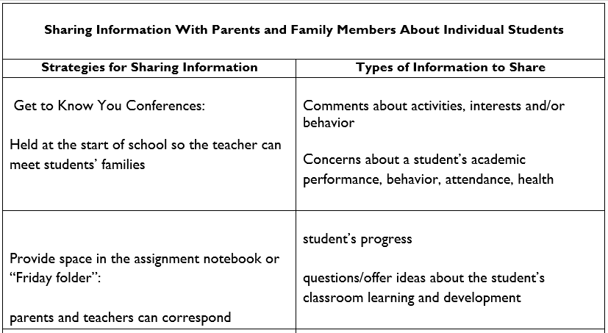
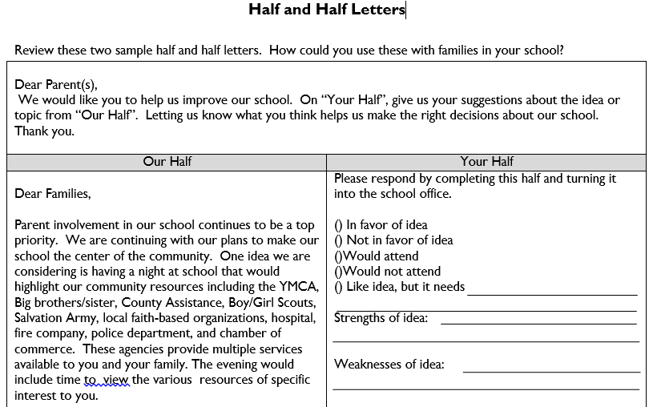
Activity 2.3
Ways to Promote Two-Way Communication
Notes:
Taking all that we have discussed about two-way communications – including the communication process framework – let’s consider how we can apply what we’ve learned in order to enhance our communications WITH, not AT, family members. Two-way communications with family members either revolve around the individual student, the class that the student is in, or the school in general. Our challenge will be to think outside of the box and brainstorm novel strategies for two-way communications with family members along with the types of information we could share when implementing the strategy.
To reflect upon this topic further, please refer to Activity 2.4 in the “Activities” folder of this module.
Refer to Activity 2.4: The purpose of this activity is to identify ways to enhance current two-way communication strategies to share information with family members in an effort to support student learning.
Debrief Activity 2.4: What can we take away from completing this activity? What recommendations does the group have to ensure we effectively communicate with family members?

Slide 26
Building Positive Communication

Slide 27
Action Steps for Communication
Communicate in a variety of ways, including both no-tech and digital means
Maintain courteous, timely, and professional interactions regardless of type of communication
Ensure that a positive communication occurs before a negative
Establish frequent, ongoing communication immediately or before the start of school
Define expectations for home-school communication
Notes:
The first step to establishing a strong communication system between schools and families is to acknowledge its importance. Schools should define their expectations for home-school communication by considering what they hope to communicate, the ideal frequency of communication, types of acceptable communication, and timelines for communication. It is vital that schools express these expectations to teachers prior to the start of the school year and emphasize the importance of home-school connections. Some schools find successful in rewarding
School districts must also emphasize the importance of positive messages home. The first messages of the year should be positive and welcoming to build rapport with families. And not only should positive communications occur first, but they should also occur more often than negative communications. It is unfortunate when parents experience dread at the sight of a note home or at the appearance of the school’s phone number on their caller ID. This is not a good way to build collaborative partnerships. Any of the following are examples of positive communication: “Your child is showing great progress in _______.”; “Your child seems very motivated by _______.”; “I am really impressed by your child’s attendance in school.”; “Your child is very friendly and gets along well with his peers.” Encourage teachers to use these to establish relationships with families early on.
In addition to being primarily positive, it is important that communication is frequent and ongoing. Teachers who communicate with their families on a daily basis are more likely to build strong relationships than those who communicate sporadically. Daily communication can take on several forms, depending on the needs of the school community. Digital communication platforms such as Class Dojo may be utilized for frequent communication in some schools, while texting, handwritten notes in agendas, or messages from educational portals may occur in others. Whatever the primary means of communication, remember that it is necessary to use multiple means of communication. For example, digital and non-digital interactions must occur since not all families may have the ability to access the Internet. Also, schools should note that some information is provided better in certain forms than others. It is more personal and more effective to address a concern during a phone call or live conversation, than an impersonal letter home when possible.
However you choose to communicate with families, remember to remain courteous and professional at all times. Some communicative interactions may be upsetting for families. After all, no one looks forward to hearing that their child has a learning challenge, is being bullied, or has misbehaved in school. Maintaining an attitude of caring is necessary to preserve relationships during these difficult interactions. Responding to communication in a timely manner also demonstrates caring for the student and respect for the family supporting that student.

Slide 28
Action Steps for Written Communication
Include mission statements and goals as part of ongoing communication
Avoid jargon and acronym and be aware of readability levels
Be clear, concise and organized in your presentation
Begin and end written communication in positive ways
Consider whether writing is the most effective means of communication
Address accessibility concerns
Notes:
Written communication is more important than ever in this modern age, as we produce a great deal of such communication both digitally and on paper. When there is doubt about whether communication should be preserved for purposes of legality, for example, we immediately default to the old adage: Can I get that in writing? However, research shows that some information, particularly that which is personal to a specific student, is preferably received in a conversation. Sensitive information might be better shared in a conversation, rather than in a letter home, in order to support the family. However, information such as school mission statements and goals might be most easily shared in writing, either through documents or the school website. It is always important to begin and end written communication in positive. For example, if you are sending an email to families to address a lack of funding for the school music, you might want to begin the correspondence by describing how inspiring the school chorus was as their concert and end with strategies that are being implemented to support continuation of musical programming.
Because written communication often exists on its own, without an accompanying conversation, it is important to ensure that your families understand the communication as much as possible. All written communication should be provided in multiple languages, depending on the needs of the school community. Avoid using jargon and acronyms that families may not understand OR define jargons and acronyms if the family might hear them in the future. Be clear and concise in your communication but also be thorough and provide the information that is necessary. Monitor readability levels of documents to ascertain their level of understandability. Be aware of accessibility and know how to produce accessible documents on basic platforms like Microsoft and iOS. Accessibility has become a requirement, not a luxury, and should be considered necessary in all school documents.

Slide 29
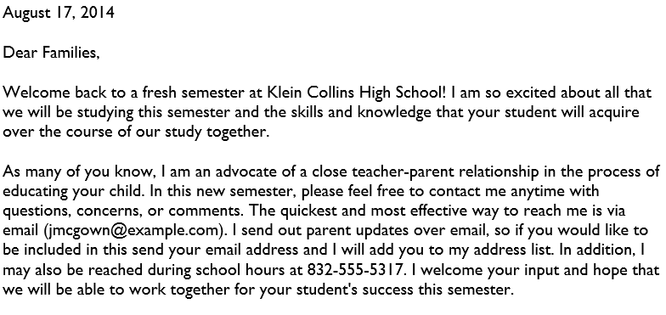
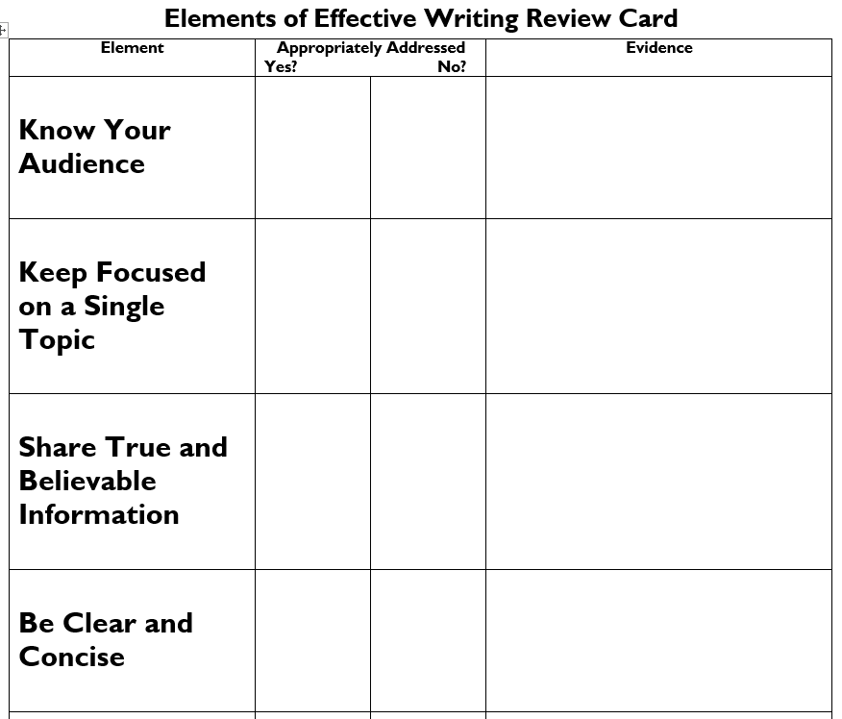
Elements of Effective Writing
Activity 2.4
Notes:
Because we are not able to immediately check for understanding when using written communication, we need to ensure that the messages we are sending are clear and understood by our audiences. You may access Activity 2.7 within the “Activities” folder to practice using the elements of a Written Communication Checklist in order to increase clarity of written communication.
Refer to Activity 2.7: The purpose of this letter is to determine which elements of the Written Communication Checklist are appropriately addressed using the practice letter and discuss the implications of effective written communication practices.
Debrief Activity 2.7: What did you learn about the sample parent letter when applying the “Elements of Effective Writing Review Card”? Was the communication clear? What improvements could be made to increase clarity of communication?

Slide 30
Considerations for Digital Communication
Availability of internet access
Speed of internet access
Availability of devices and related equipment
Types of digital communication
No-tech or low-tech alternatives to digital communication
Notes:
Digital communication is an ever-evolving form of interaction that grows and changes, seemingly at the speed of light. It is important that schools establish modes of digital communication, but it is even more vital that they consider the needs of the individuals within their local educational agencies (LEAs) when making decisions about using technology for communication.
Ultimately, school policies and procedures are shaped by the resources and needs of the school district itself. One of the first questions to consider is how many families have access to digital communication. What is the availability of internet access in the community? If many families are without internet, are there community resources that schools can refer them to in order to get connected? Surveys may be used to elicit this information, but they should be provided on paper as well as digitally. Consider personal phone calls home as a back-up plan to obtain this information.
In addition to asking families about availability of the internet, schools might want to gain information about internet speed. This is most useful if the school is considering the possibility of live streaming, which requires Internet speeds of at least 200Mbps. Other considerations involve availability of equipment. A tablet or laptop might be necessary to support participation in online learning platforms, but smartphone access might be sufficient for website access, texting, or use of communication platforms, such as SeeSaw, Remind, or Class Dojo. It is not enough to ask families whether they have a device. Rather, schools must consider how the devices will be used and how many devices will be needed. If a school is expecting multiple children in a household to livestream at the same time, a device is necessary for each child. If a school wants kids to be able to be visually present during an activity, a webcam of some sort (whether built-in or separate) may be required. Once again, the school must note the purpose of using digital communication and how it might impact education.
The final important consideration for the use of technology in communication is that it sometimes doesn’t work. Many factors can influence whether a digital communicative interaction is successful. Internet access, devices, bandwidth, throughput, glitches, dead links, audio clipping, electrical outages… all of these might influence whether communication is able to take place in a digital format. It’s important to have a back-up plan. Sending home information in a paper format and using call blasting systems are just two alternatives to digital communication.

Slide 31
Action Steps for Digital Communication
Establish policies and procedures for digital communication
Train teachers on how to use digital communication types
Provide training to families on the use of communication platforms
Use a variety of digital means of communication: website, email, texting, videos, blogs, etc…
Vary types of communication depending on the information you want to share
Notes:
There are several action steps that schools must put in place when establishing norms for digital communication. First of all, they must think about their policies and procedures regarding technology. What modes of digital communication are available to the school? What guidelines should educators follow when using digital communication? What types of information does the school hope to disseminate in digital ways and what impact will this have on education? Even issues such as cybersecurity and platform cost will factor into digital communication guidelines.
While Internet access and equipment are important, familiarity with digital communication platforms and the families’ ability to support their children through use of technology is vital. Consider providing training for families at school events. These trainings should address useful topics, such as how to use educational portals to access grades and homework. Refer families to online tutorials when needed but be specific about it. Send them the link directly, rather than asking them to find the tutorials for themselves – they may not know what to look for. Prepare your families for digital communication BEFORE you use it, when possible. For example, if you are using a teleconferencing platform, such as Zoom, for an IEP meeting, send the families some tips about the platform in advance and sign on early so they can troubleshoot using the features of the platform.

Slide 32
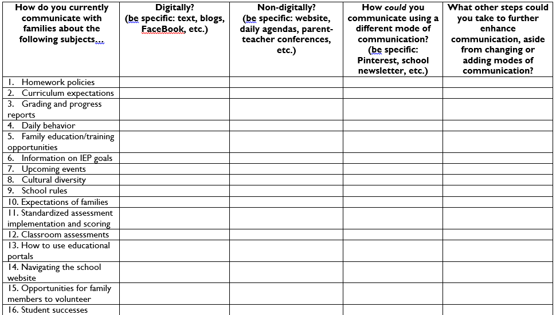
The Digital Age
Activity 2.5
Notes:
To reflect upon this topic further, please refer to Activity 2.8 within the “Activities” folder of this module.
Refer to Activity 2.6:
The purpose of this activity is to discuss ways in which educators communicate with families about a variety of subjects and to determine whether digital or non-digital means of communication are used, and whether changes of means of communication could, perhaps, enhance the communicative process.
Debrief Activity 2.6: What types of digital communication are utilized within your school? Are they implemented successfully? Could digital communication be explored further?

Slide 33
Promoting Communication
Quick Tips
Establish collaborative partnerships
Provide multiple means for families to communicate
Teach families how to use communicative tools
Include family members on school committees
Ask about family member their opinion
Successful schools solicit, encourage, facilitate and promote parental communication.
(Lavoie, 2008)
Notes:
Research shows that communicating with families is a strong component of practice within successful schools. However, it is important to note that successful communication does not occur if we simply only talk at families. Rather, as one researcher stated, “Successful schools solicit, encourage, facilitate and promote parental communication.” Throughout our communication, we need to make sure that we are encouraging families to communicate with us as well. The first step to promoting such communication is recognizing that all families have strengths. They all care about their kids and are able to contribute to a collaborative partnership between home and school. Give parents credit for being the experts on their children and for providing important information that impacts educational success. Structures set in place through the Every Student Succeeds Act (ESSA) and the Individuals with Disabilities Education Act (IDEA) support these partnerships but schools must also encourage staff members to welcome families’ opinions.
Rather than talking at parents, we need to talk with parents. Provide families with opportunities to converse with us, whether it’s through an informal means such as casual conversation or texting, formal interactions like parent-teacher conferences, or during social events, such as Back-to-School night. Make sure that families know your available contact information – phone numbers, email addresses, access to communication platforms like Remind or Class Dojo, the school web address, social media platforms like Facebook or Instagram, etc. Offer trainings on how to participate in digital communication platforms and have resources available to help families establish a digital footprint.
Encourage your family members to form parent organizations and networks within your school and also give them opportunities to join school committees, such as the curriculum committee or tech committee. Ask families about what they need regarding both communication and the skills to participate in that communication – they might have great ideas on how to disseminate important information. They might also have creative suggestions about a variety of aspects of education, including literacy programs, math interventions, positive behavior intervention and support, extracurricular activities… the list goes on.

Slide 34
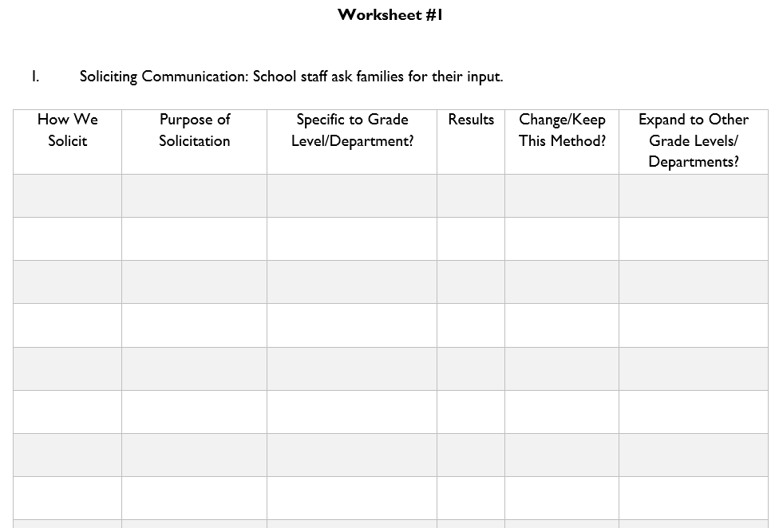
Enhancing Communication
Activity 2.6
Notes:
Have we really taken the time to consider how our school is using communication as a means to successfully engage families? Effective schools do not simply communicate. They increase the value of communication by soliciting - asking families for their input, facilitating - assisting families in understanding how to communicate their concerns, ideas, and needs, promoting – advertising the existing opportunities for open, ongoing dialogue, and encouraging – creating an environment of open communication where families communicate freely and staff openly provide feedback.
Activity 2.7 will explore the ways in which your school is soliciting, facilitating, promoting, and encouraging communication. You may access this activity within the “Activities” folder of this module.
Refer to Activity 2.7: The purpose of this activity is to identify how we communicate with families. How does our school currently use the different ways of enhancing communication(soliciting, promoting, encouraging, facilitating) and are these ways yielding the results we want?
Debrief Activity 2.7: How do we ask for input from families? Are some ways of soliciting information more successful than others? What alternate strategies might be use to increase communication?

Slide 35
References
Caspe, M. Home-School Communication – What’s All the Commotion? Retrieved on October 22, 2015 from https://archive.globalfrp.org/family-involvement/publications-resources/home-school-communication-what-s-all-the-commotion
Henderson, A., Mapp, K., Johnson, V., & Davies, D. (2007). Beyond the bake sale: The essential guide to family-school partnerships. New York: New Press.
James, D.W., Jurich, S., & Estes, S. (2001) Raising minority academic achievement: A compendium of education programs and practices. Washington, D.C. American Youth Policy Forum.
McDermott, P.C., Rothenberg, J.J. (2001). New teachers communicating effectively with low-income urban parents. Annual Meeting of American Educational Research Association, Seattle, WA, April 10-14, 2001.
Mapp, K. L., Carver, I., & Lander, J. (2017). Powerful partnerships: a teachers guide to engaging families for student success. New York, NY: Scholastic.
Meador, D. (2020, February 4) School Communication Policy: ThoughtsCo https://www.thoughtco.com/school-communication-policy-3194670

Slide 36
PaTTAN – East 1-800-441-3215 Kimberly Jenkins kjenkins@pattan.net PaTTAN – Harrisburg 1-800-360-7282 Erin Campion ecampion@pattan.net PaTTAN – Pittsburgh 1-800-446-5607 Jennifer Geibel jgeibel@pattan.net

