Slide 1


PBIS: RtIIB
Coaching 101
Pennsylvania PBS Network
2011-12
Notes:
School-wide Positive Behavioral Interventions and Supports (SWPBIS) requires Coaching as a Key element to support system change.
This session provides an Overview for Coaches, outlining the foundations of SWPBIS as a Response to Instruction and Intervention Framework for Behavior (RtII:B) and providing information on the essentials of the coaching process that District and Building Coaches will need to master to be effective support personnel for their Core Teams.
In addition to reviewing the relationship between academics (RtII:A) and behavior (RtII:B), this module will explore the critical functions of coaching: Facilitator for the Team process (working with Teams); Content/Knowledge (what you need to know and do); and Communicator (effectively communicating to others the process and progress of the schools efforts to build a positive Social Culture).

Slide 2
Acknowledgement
The presentation and material for this session was created by Florida’s Positive Behavior Support Project through the University of Florida, Louis de la Parte Florida Mental health Institute funded by the State of Florida, Department of Education, Bureau of Exceptional Education and Student Services, through federal assistance under the Individuals with Disabilities Education Act (IDEA, Part B)
The session was adapted for Pennsylvania’s PBS Network by its Regional Facilitators, with additional material added and supplemented as relevant to Pennsylvania’s SWPBIS/RtIIB initiatives.
Notes:
To better familiarize oneself with the primary content of this workshop, i.e., content exclusive of the slides pertaining to Pennsylvania, one may logon to the Florida Coaching website and review the online module from which this training session was adapted. However, the trainer notes follow the web-version almost in its entirety.
The url is: http://flpbs.fmhi.usf.edu/Web_Training_Coaches_101.asp
Registration is required, but it is free. One may revisit the site as often as one wishes.

Slide 3
Agenda
Overview of PBIS: RtIIB
  RtIIB
  Systems Change
Overview of School-Wide PBIS
  Structure
  Expectations
PBIS Coaching Functions
  Facilitator
  Content/Knowledge
  Communicator
Resources
Notes:
Coaching 101 will provide a description of Response to Instruction and Intervention and SWPBIS.
Then we will get into skills including your role as facilitator, presenter of content and knowledge, and communicator that will assist you to guide and lead schools in their implementation of SWPBIS.
Finally, resources are provided to assist you with information and materials to help you with coaching.

Slide 4
Objectives
At the end of today’s session, you will be able to…
Describe the three functions of coaching
Identify your strengths as a PBS Coach
Identify your areas of need as a PBS Coach
Identify resources to enhance your role as a PBS Coach
Notes:
By the end of this session, we believe you should be able to identify the three functions of coaching, to identify your strengths and needs, and to be able to identify resources to help you in your role as a coach.

Slide 5
PBIS: RtIIB Overview
Notes:
We will begin with an overview of Response to Instruction and Intervention for Behavior.

Slide 6
RtII Principles
Multi-tiered approach
Problem-solving process
Evidence-based instruction and interventions
Data-based decision-making
Progress monitoring
Notes:
You may be familiar with these 5 principles of RtII.
RtII is a system, framework, a process to reach all children to meet their needs through a multi-tiered approach, using a problem-solving process based on driven decision-making to apply evidenced-based instruction and interventions that are monitored to determine a student’s response. In other words, are the instruction and interventions working for the student?
* Response to Instruction and Intervention for BEHAVIOR is also founded on these 5 principles.

Slide 7
PBIS: RtIIB Supports
Federal Mandates
  No Child Left Behind
  IDEA 2004
State Requirements for Student Supports
  Chapter 12
  Chapter 14
Best Practice
  Research-based
  Data-driven
  Aligned with PA Standards
  Family involvement
Notes:
There are a variety of laws, regulations, and legal mandates to support the use of RtII, as well as good research that has driven the move toward RtII.
In addition to Federal laws, PA State Regulations, provide a basis and requirement for monitoring and addressing student emotional and social needs by requiring screening, early identification, intervention, and progress monitoring. They are intended to remove non-academic barriers to learning as noted in NCLB.
While RtII itself is not mandated, the RtII framework and principles fulfill the requirements of these laws.
Furthermore, PA has adopted School Climate standards and is in the process of adopting Interpersonal Skills standards that will require school staff to address social, emotional, and academic learning skills. SWPBIS an RtII: B framework will assist schools to address these issues.
Question (somewhat rhetorical):
If a district is not using RtII, then how is it addressing all the legal mandates.

Slide 8
PBIS: RtIIB
PBIS:RtIIB
  A systems approach for establishing the social culture and individualized behavioral supports needed for schools to be effective learning environments for ALL students.
Critical Elements
  - PBIS Team & Administrative Support
  Faculty Commitment, Participation
  Effective Discipline
  Data Entry & Analysis
  Expectations and Routines
  Acknowledgement / Recognition System
Lesson Plans for Teaching Behavior
Implementation Planning
Crisis Planning
Assessment, Progress Monitoring
Classroom PBIS Systems
Notes:
PBIS is a systems approach…
The Critical Elements of a Tier 1 (Universal) SWPBIS system are illustrated here. Each one of these Critical Elements is covered in the SW Benchmarks of Quality measure and is explicitly taught in our 3-day Universal Training for school-based Core teams.

Slide 9
Keys for Establishing PBIS: RtIIB
Effective, committed leadership (district and school levels)
Effective school-based teaming
Faculty commitment
Evidence-based practices at all tiers*
  Tier 1 – Universal (for all students)
  Tier 2 – Secondary (for some students)
  Tier 3 – Tertiary (for a few students)
* Note: These are zones of support, not students or places
Notes:
Refrain from labeling students as “green,” “yellow,” or “red” kids.
SWPBIS has been established in over 14,000 schools nationally and in over 250 schools in PA.
Several keys for establishing SWPBIS for behavior may be identified
First of all, commitment of leadership at the district and school levels is essential.
School-based teaming, where the “rubber meets the road,” the team that goes through the training and assists the faculty to implement the SWPBIS systems across the school campus, how they interact together and meet together to achieve the goals is critical.
Faculty must be committed and the core team’s efforts to involving, informing, and engaging the faculty is important to PBS in the school.
Evidenced-based practice must be used at all Tiers.
The universal system of SWPBIS following the key elements must be implemented with Fidelity.
Tier 2 supports must be evidenced based and there must be supporting documentation that interventions selected are appropriate and effective for the identified problem/issue and that the correct students are identified and matched with the appropriate interventions.
At Tier 3, there is information about what constitutes effective, evidence-based practices for individual students.
- Throughout all of these Tiers and teaming situations, there must be data collected and used for data-driven decision-making, to progress monitor success, and to evaluate the process.

Slide 10
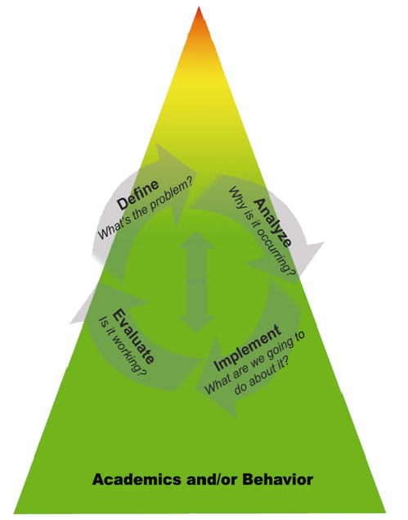
Tiered Model of School Supports and the Problem-Solving Process
ACADEMIC and BEHAVIOR SYSTEMS
Tier 3: Intensive, Individualized Interventions & Supports
The most intense (increased time, narrowed focus, reduced group size) instruction and intervention based upon individual student need provided in addition to and aligned with Tier 1 & 2 academic and behavior instruction and supports.
Tier 2: Targeted, Supplemental Interventions & Supports
More targeted instruction/intervention and supplemental support in addition to and aligned with the core academic and behavior curriculum.
Tier 1: Core, Universal
Instruction & Supports
General academic and behavior instruction and support provided to all students in all settings.
RtI State Transformation Team – FL DOE (12/3/09)
Notes:
10
A good place to start any discussion of School-Wide PBS is this graphic. It is based on the Public Health Model that describes a student support system of Primary, Secondary and Tertiary prevention. The single triangle is intended to emphasize that prevention of both academic and behavioral difficulties needs to be addressed.
As such, participants may see that the overall approach to providing a Response to Instruction and Intervention Framework is similar for academic systems or social, emotional, and academic learning systems. The systems are supported by system resources, data, and evidence-based practices to achieve the valued outcomes desired by the school and community.
The triangles also describe what the supports for students of a typical school may look like. In most schools 80 to 90% of students arrive prepared to do the work of attending school. They have the learning ability, the motivation, support systems and personality to be successful in schools. About 10 to 15% of students will be at-risk for learning and or behavior problems. (Add a few descriptors of at-risk students) And then there are bout 1-5% of students who seriously and chronically in trouble academically and behaviorally (add a few descriptors of high-risk students).
Ask, “Would you agree that this (at least) broadly describes the students who attend your school?” (Get some acknowledgement form the group that this is true. They may quibble a little about the actual ranges but look for the big idea.)
If they do agree then go to the next point which is about the implications for intervention:
No single intervention or approach will meet all the behavioral needs within a school. Think of the student handbook as an example. Most school have the handbook which lists the behavior infractions and the punishments that go with them. “Which group will be best supported by the student handbook?” (The 80-90 percent group or Green zone support for kids!)
The handbook will work less well for the at-risk group and probably not at all for the high risk students. Students at higher risk levels will need more targeted and intensive supports to be successful in school.
Some examples of additional supports would be “Check-in/Check-out” programs, Homework Club. Newcomers Club, counseling/support groups for the at-risk group and FBA and Individual Student Planning processes for high risk student.
Assumptions:
No single intervention or approach will meet all the behavioral needs within a school.
85-90% of students will arrive at school already having learned the important social skills necessary to "do school."
7-10% of students needs the supportive resources in school (e.g. academic support, counselors, and extra adult attention) in order to be successful.
3-5% of students requires intensive individualized intervention.
http://www.florida-rti.org/flMod/threeTierModel.htm

Slide 11
RTII
Integrated
Continuum of Support for ALL
Universal
Targeted
Intensive
Math
Science
Spanish
Reading
Soc skills
Soc Studies
Basketball
Label behavior…not people
Dec 7, 2007
Notes:
The RtII continuum represents zones of support, not places or students.
Any individual student may need a mix of supports depending on their skill level in any given area.
For example, this fourth grade student is great at social studies and basketball, fairly good social skills, but may need some moderate support for reading and Spanish, but intensive support for science and math.
By the way – the “red star” signifies concepts that are extremely important to remember.

Slide 12
PBIS: RtIIB Goal
- System Change -
Change the environment so…
  It is more efficient and effective for staff to use PBS:RtIIB as “the way we do business”
    Train, support, technical assistance, technology
  All students have the ability to respond and function more efficiently and effectively
    Teach, reinforce, multiple tiers of support, skill enhancement
  All decisions are driven by data
    Problem identification
    Problem analysis
    Interventions
    Evaluation
  ALL students needs are met… The Triangle
Notes:
The RtII approach for Behavior is about changing the environment, the social culture of the school.
It is a system change by which we must make it more efficient and effective for staff to use PBIS:RtIIB as business as usual.
As staff teach, reinforce, use multiple tiers of support, and promote enhancement of social, emotional, and academic learning skills, students will be able to respond and function better academically and behaviorally.
When system change is undertaken, it is crucial that all decisions are driven by data.
This data is often used within a problem solving model, the basic steps of which are described here.
Through this systems change, then, the needs of all students are met.

Slide 13
SCHOOL-WIDE Leadership team Behavior purpose statement Set of positive expectations & behaviors Procedures for teaching SW & classroom-wide expected behavior Continuum of procedures for encouraging expected behavior Continuum of procedures for discouraging rule violations Procedures for on-going data-based monitoring & evaluation | Changing the System “How things are done” | CLASSROOM All school-wide Maximum structure & predictability in routines & environment Positively stated expectations posted, taught, reviewed, prompted, & supervised. Maximum engagement through high rates of opportunities to respond, delivery of evidence-based instructional curriculum & practices Continuum of strategies to acknowledge displays of appropriate behavior. Continuum of strategies for responding to inappropriate behavior.
INDIVIDUAL STUDENT Behavioral competence at school & district levels Function-based behavior support planning Team- & data-based decision making Comprehensive person-centered planning & wraparound processes Targeted social skills & self-management instruction Individualized instructional & curricular accommodations | NONCLASSROOM Positive expectations & routines taught & encouraged Active supervision by all staff (scan, move, interact) Pre-corrections & reminders Positive reinforcement | FAMILY ENGAGEMENT Continuum of positive behavior support for all families Frequent, regular positive contacts, communications, & acknowledgements Formal & active participation & involvement as equal partner Access to system of integrated school & community resources
Notes:
These are the elements that establish the foundation or Universal Level of SWPBIS. It is also known as Tier 1.
In changing the system, we actually change “How things are done.”
Procedural changes occur in non-classroom settings
Assemblies
Bathroom
Bus
Cafeteria
Gym, playground
Hallways
Teaching expectations
Reinforcing appropriate behavior
Teaching and modeling alternative behavior
Meeting the needs of All students … The Triangle

Slide 14
Changing the System
“How decisions are made”
Data-Based Decision-Making:
  Data Collection
    ODRs, ISS, OSS, absences, positive referrals, universal screening, etc.
  Review and analysis
    Monthly review of current data
    Team Initiated Problem-Solving Model (TIPS)
  Sharing
    Patterns of behavior (location, time, student, staff, type of problem)
    Behavior improvements
    Behavior challenges
Notes:
In an RtII system for Behavior, decisions are made based on data.
It is important that data that is collected is meaningful. Just as importantly, the data needs to be used, i.e., reviewed and analyzed on a regular basis and processed through a team problem-solving model. We will discuss the Team Initiated Problem-Solving Model in more detail later.
Look at data, ask questions, and then share the data with faculty and other stakeholders, noting how problems are resolved, successes achieved, as well as challenges that we are having.

Slide 15
Changing the System
“How staff interact with Students”
PBIS Practices:
  Teach behavior like we teach academics
  Model and practice expected behaviors
  Acknowledge / reinforce expected behaviors
  Pre-correct / prompt to ensure positive behaviors are displayed
  Active supervision to prevent problem behaviors
Notes:
PBIS is about changing “how staff interact with students.” Again, a change in the social culture of the school is promoted and fostered through research supported practices.
The PBIS practices that staff carry out will effect the behavior of students.
When we Teach behavior like academics, Model and Practice expected behaviors, Acknowledge and Reinforce expected behaviors, Pre-correct and Prompt for positive behaviors, and Actively Supervise we will be effective.

Slide 16
Challenges
Doing more, with less
  Staff, time, funding, resources
Educating an increasing number of students who are more different than similar
  Teach and model
Educating students with more challenging behaviors
  Continuum of services
Creating environments (systems) that allow for the adoption and sustained use of effective practices
  Think outside the box
Notes:
We’re all aware of the challenges we face in system change. None are new to you.
It is important if we are to have an effective and efficient process that we work to overcome them.
Given the 4 PBIS elements of Outcomes, achieved through the effective application of Systems, Data, and Practices, it is important to have the system resources to support staff, time for meetings, funding, and other necessary resources.
When system supports are sufficient, staff may provide a greater continuum of supports and handle increasing numbers and diversity of challenges presented through student behavior.
Creative problem-solving is KEY!

Slide 17
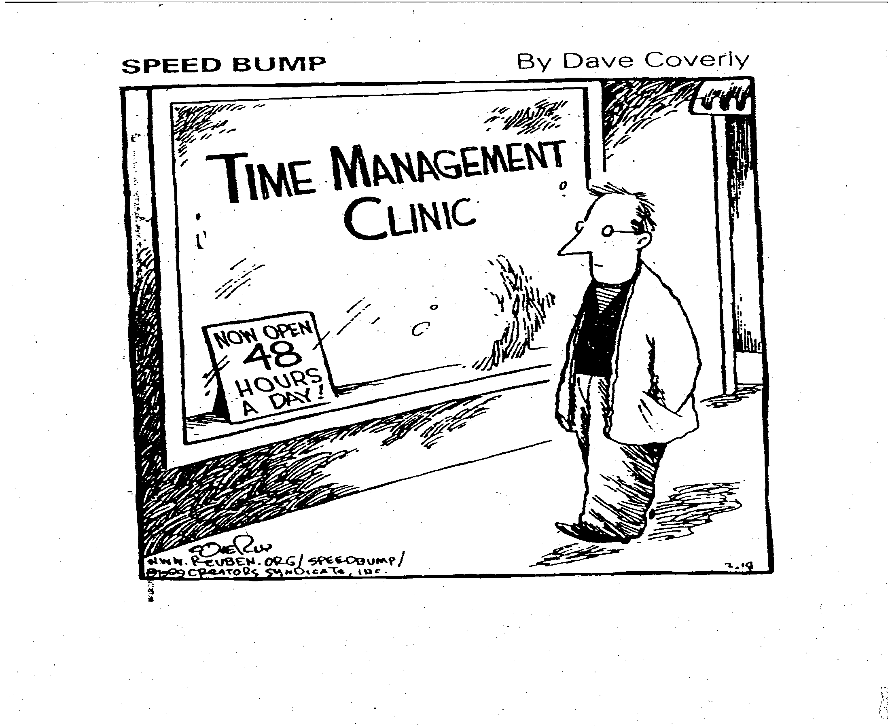
Notes:
One of the greatest challenges we face is TIME!
How do we fit everything in?
System’s Replacement Behavior:
Let’s think about having a “replacement behavior” for the System, i.e.,
Team Reorganization
Work smarter, not harder…
Not a cliché. School personnel need to streamline committees and work groups to maximize use of time and expertise.
Refer to Working Smarter Not Harder Matrix and the need to consolidate practices/programs within the school – eliminating those that do not have intended effects or data to support them (or start collecting data to prove their worth) and combining those with similar goals that are effective.
Keep only those that have data to support their use!

Slide 18
PBIS:RtIIB
District and School-Based Systems
Notes:
We’re going to shift not to a discussion of RtIIB and the district and school systems that support it.

Slide 19
PBIS: RtIIB Systems Implementation Logic
You are Here
Notes:
This graphic illustrates the system of RtII for behavior support and interventions. The state, district, and school building level use the same structure. It is part of the Blueprint for effective implementation.
The Green box represents your district leadership team. You DLT helps to consider areas like funding, visibility, political support, and policy changes that may be necessary for PBIS to happen.
It also helps to coordinate things like training for your school-based teams and teachers. It coordinates the coaches that help to facilitate the process and maintain evaluations to assist with identifying how you are moving through the system change and the kinds of outcomes you are experiencing. They will make sure you have the behavioral expertise available to make these supports effective.
[Click]
Then, there is you, the coach, at the local/district school level.

Slide 20
Avoid “Train & Hope”
REACT to
Problem
Behavior
Select &
ADD
Practice
Hire EXPERT
to Train
Practice
Expect, But
HOPE for
Implementation
WAIT for
New
Problem
Notes:
We know that to “Train” and then “Hope” something happens is futile!
In many schools, a typical response to an academic or behavioral issue is to…
React to Problem
Add a practice
Hire Expert to train it
Hope it gets implemented
Wait…for the next problem and then a new problem happens
The Cycle continues…
Therefore, follow-up with Technical Assistance and Coaching is crucial to install the practice or process, ensure it is delivered with fidelity, and sustain its implementation.
(See next slide for research support…)

Slide 21
Training Outcomes Related to Training Components
 | Training Outcomes
Training Components | Knowledge of Content | Skill Implementation | Classroom Application
Presentation/ Lecture
Plus Demonstration
Plus Practice
Plus Coaching/ Admin Support Data Feedback
10% 5% 0%
30% 20% 0%
60% 60% 5%
95% 95% 95%
Joyce & Showers, 2002
Notes:
There is a huge discrepancy between the methodologies of presentation/lecture, even including demonstration and presentation/demonstration/practice PLUS on-going coaching, administrative support and data collection and analysis. This is what we strive for – this is what is effective and what makes SWPBS unique.
We know effective training is not enough. The T&H approach will allow 10% or less of the Content to be put into practice.
Adding Demonstration helps a little more but still only 30% gets put into place.
The ability to incorporate practice helps significantly to apply what is learned and to increase fluency with the skills learned.
But, COACHING, when you add Coaching, you increase the implementation to 95%. Administrative support and feedback on performance with data is also crtitical.
So, this is why PBIS for RtIIB is modeled on a coaching plan. YOU, the coach, are critical to the process.

Slide 22
PBIS Coaches
Notes:
So, now we will focus more on you, the PBIS Coach, that critical part of the process.

Slide 23
PBIS: RtIIB Support Structure
Regional Facilitator
School-wide Facilitator
District Coordinator / Coach (DLT)
PBS Coach
(Building)
PBS Team
(School Administrator)
Faculty and Staff
Notes:
The support structure for PBIS looks something like this.
Remember the graphic with the DLT? Well, as we said, it works from the state level to the building level.
The state leadership provides Regional Facilitators that assist with coordination of activities of SWFs, Coaches, and District/Building implementation in his/her respective region. In PA, these are the western, central, and eastern regions supported by PaTTAN Consultants.
IUs, agencies, universities, and LEAs offer School-wide PBIS Facilitators that train and provide technical assistance to districts and schools on implementing SWPBIS.
Some districts may have a District Coordinator that may or may not be the District Coach. Could be one person fulfilling the functions of both, or separate individuals. This individual supports multiple building level coaches and core teams within a district. They may often serve as the primary liaison between the District Leadership Team and the Building Teams.
PBS Coach is at the Building level. May serve multiple schools. Guideline up to 5 buildings per coach that would provide roughly a 1 day FTE a week support for SWPBIS in each building

Slide 24
District Coordinator Expectations
Active participant on district leadership team
Secure funding sources for PBS-related activities
Visibility and political support in the district
Ensure / schedule training for PBIS Teams
Support and mentor PBIS Coaches
Evaluate PBS data and implementation process
Notes:
What can you expect of a District Coordinator?
As we said, they will act as a liaison between the DLT and the Buildings.
They may assist with getting funding support for PBIS activities within the District.
A DC may work with the DLT to promote information about the PBIS implementation and garner local political support for the process within the community.
A DC may be the individual that works with School-wide Facilitators to schedule needed training and on-going technical assistance.
They are the primary support and provide guidance and mentoring for PBIS Coaches within the District.
District Coordinators ensure that teams use data to drive decision-making and ensure fidelity of implementation and evaluate data to determine the effectiveness of implementation. They may be the main contact with SWF and Regional Facilitators and coordinate District-wide PBIS assessment protocols and schedules, ensuring that data is collected and submitted as requested.

Slide 25
Coaches Expectations
Sustainability and accountability of the team
  Technical assistance
  Problem-solving (data)
  Positive support and prompting (“positive nag”)
Use Action Plan for fidelity
Provide behavioral knowledge and build behavioral capacity
Provide a link between PBIS Team and District Coordinator
Ongoing communication with stakeholders (i.e., administrator, staff, families)
Return Network requested data
  School Profile, PIC, BoQ, etc.
Take them to “Implementation with Fidelity Status”
Notes:
As a Coach, what is expected of You?
Expected to support school-based team and ensure accountability.
Ensure the Core Team receives the kind of assistance they need through the DC and other resources.
Make sure the problem-solving process is used by teams and that data is available and used in making-decisions.
You are the “positive nag” to keep the team moving along towards effective implementation.
You will use Action Plans to make sure fidelity of implementation is happening.
You’ll make sure the Teams have adequate behavioral knowledge and build that capacity within the Team.
You’ll be the link between the District Coach/Coordinator who will be your next level of support.
You’ll be making sure there is on-going communication for all stakeholders within the school and community.
You will be responsible for ensuring that mid and end-year reports are submitted. We will discuss this more later.
Finally, you’ll be continuing to assist them and take them to Implementation with Fidelity status.

Slide 26
School Administrator Expectations
Active participant on the SWPBS Team
  Attends monthly team meetings
Visible role on campus
  Communicates commitment to the PBIS process via newsletters, awards, announcements, trainings
Support PBIS Coaches
Resources and funding
Notes:
What should be expected of your school administrator?
As we discussed earlier, Administrator involvement is essential to ensure the success of this process.
Administrative leadership should be visible and the Administrator should be an active participant on the SWPBIS Team. Attending meetings and being engaged in all the activities.
They should support the team and SWPBIS by speaking about PBIS, talking about it in announcements, at faculty meetings, and at community gatherings.
They should be supporting your activities as a PBIS coach and can be a valuable resource for securing funding and time.

Slide 27
Team Leader Expectations
Schedule monthly meetings
Prepare agenda
  Email agenda and meeting reminder
Facilitate team meetings
  Keep team on track and focused
  Provide positive support
Primary contact with PBIS Coach
  Team Leader and “Building” Coach may be same person
Notes:
What can you expect of a Team Leader?
Sometimes the Coach assumes these, other times they are held by a separate individual. Regardless, these functions need to be fulfilled.
Need to have someone identified to schedule monthly meetings. Preferably, established at the beginning of the school year.
Need to prepare agendas and send out before hand and remind team members of upcoming meetings. Complete minutes of the meeting and send them out as a reminder of the outcomes and actions necessary.
The Team Leader facilitates the meetings and assists with keeping the team on track and focused, following the agenda and providing support.
If the Team Leader is not the Coach, then they are the primary contact for the Team to the Coach.

Slide 28
What Am I Expected To Do?
Are you a Building or District Coach?
Are you the team leader or does another member serve as the team leader?
Notes:
So, what are your expectations?
What is your role?
Knowledge of your role and the expectations for that role is essential to the SWPBIS process.
Each Team member needs to be familiar with and secure in the knowledge and skills necessary for them to fulfill their role.
The training provided by the PA PBS Network for Facilitators, Coaches, and Teams is designed to provide the information and support to help each team member and team to be successful…and to have successful implementation outcomes.

Slide 29
Self-Assessment of Coaching
Take out the “RtIIB/SWPBS Coaches Training” Worksheet. This worksheet will support you to take some notes through the remaining training activities and to assess your strengths and needs as a coach
Complete the items under Section I
Notes:
Let’s take some time to review the Coaches Training Worksheet.
Please, complete the items under Section I.

Slide 30
Functions of a PBIS Coach
Notes:
You should have just completed Section I of the Coaches’ Self-Assessment.
Now we’re going to start talking about the functions of a PBS coach.

Slide 31

Coaching Functions
Team meetings
Activities at trainings
Implementation –
‘Positive Nag’
Facilitate
PBS Knowledge
Response to Instruction and Intervention
Behavioral knowledge
Link to resources
Faculty
Administrator
District Coordinator
Community
Coaching Functions
Communicate
Content and
Knowledge
Notes:
There are 3 main areas of function for you as a PBIS Coach.
One is to Facilitate, another is the area of Content and Knowledge, and the third is to communicate.
We will concentrate on these functions for the remainder of this training.

Slide 32
Coach as Facilitator
Facilitate
Create a positive, supportive environment
Create and ensure structure
Gain team consensus
Ensure development and implementation of the PBIS Action Plan
Guide the problem-solving process
Provide tools
Notes:
We’ll start with Coach as Facilitator.
There are 6 main areas we’ll cover in terms of your responsibility as a leader of the PBIS Core Team.
We’ll review each separately.

Slide 33
1. Creating an Effective Environment
Active Listening
  Ask open-ended questions
  Paraphrase, summarize, synthesize
Behavior Management
  Observe group dynamics
  Provide positive, supportive feedback
  Refocus discussion
  Motivate
Notes:
One critical role is to create an effective environment in which your team may function.
Encourage active listening by asking open-ended questions to get at more details about what people have to say. Use strategies such as paraphrasing, summarizing, and synthesizing to validate people’s ideas and also to insure that you are interpreting them as they intended.
Consider the behavior of the group. Observe the dynamics of interaction. Is it positive, encouraging, effective? Do you need to provide positive feedback and focus to help them function in a more effective way?
How about motivating? Keeping your team excited and encouraging them in their work.

Slide 34
2. Creating Structure
Establish Ground Rules (examples)
  All members present at every meeting (if possible)
  Be on time
  Minimize interruptions (i.e., make/take phone calls, etc.)
  Tasks distributed equally among members
  Everyone is encouraged to participate
Reach Agreement on Ground Rules
Notes:
Bullet: An extension to creating an effective environment is to insure you have adequate structure. Set some ground rules you think are important and then have others add and reach agreement on them.
e.g., Discuss how to handle multiple conversations. One person at a time rule? Or, use a prop that someone may hold to indicate who has the floor, etc.
Minimize interruptions – this is where the team needs to take a position or have a policy on how interruptions should be handled; e.g., are external phone calls permitted to be received during meetings, etc.?

Slide 35
Designing Effective Meetings
Agenda prepared & delivered in advance
Review data (who, what, where, when)
Problem-solve concerns using data
  Guides all interventions and progress monitoring
Design interventions and implementation procedures
  Offer tools/resources
Update Action Plan
  Activities and products accomplished since last meeting
  Faculty buy-in
  Implementation strategies/steps
  New items for next meeting
Celebrate accomplishments
Notes:
Some things to consider…
Importance of a prepared agenda and delivered in advance.
Make sure data is available and used. And have it be at a prominent point in the meeting so it is not forgotten.
Use the TIPS process to design interventions and monitor progress.
Update the Action Plan frequently and communicate often with the faculty.
Be sure to include items for next meeting.
Don’t forget to celebrate what you have done well. The data should insure that you have the information you need and take the time to do that.
Using the TIPS (Team Initiated Problem-Solving) model will ensure that you have covered these elements. [see next slide]

Slide 36
PBIS Team Meeting Agenda / Minutes (TIPS)
Today’s Meeting: Date, time, location: Facilitator: Minute Taker: Data Analyst:
Next Meeting: Date, time, location: Facilitator: Minute Taker: Data Analyst:
Team Members (bold are present today)
Today’s Agenda Items Next Meeting Agenda Items
01. 02. 03.
Administrative/General Information and Issues
Information for Team, or Issue for Team to Address | Discussion/Decision/Task (if applicable) | Who? | By When?
Problem-Solving Action Plan
 |  | Implementation and Evaluation
Precise Problem Statement, based on review of data (What, When, Where, Who, Why) | Solution Actions (e.g., Prevent, Teach, Prompt, Reward, Correction, Extinction, Safety) | Who? | By When? | Goal, Timeline, Decision Rule, & Updates
 | Our Rating
 | Yes | So-So | No
1. Was today’s meeting a good use of our time?
2. In general, did we do a good job of tracking whether we’re completing the tasks we agreed on at previous meetings?
3. In general, have we done a good job of actually completing the tasks we agreed on at previous meetings?
4. In general, are the completed tasks having the desired effects on student behavior?
Evaluation of Team Meeting (Mark your ratings with an “X”)
Notes:
TIPS = Team Initiated Problem-Solving
This is an example of a structured team meeting.
Here we are just introducing the Form and structure. Process will be discussed in more detail as an overview in subsequent slides.
Preferred model for conducting meetings in SWPBIS.

Slide 37
3. Gaining Consensus
Review all available data
Brainstorm ideas based on data
Engage in open discussion to clarify ideas/suggestions
Identify all relevant information obtained
Prioritize ideas generated by the team
Gain verbal agreement on “next” steps
Decisions supported by all team members
Team presents united front outside of meeting
Notes:
Review all data and brainstorm ideas. Use good brainstorming structure, e.g., round-robin, do not criticize, just list and record.
Then have open discussion and consolidate ideas. Come up with a process to prioritize ideas and then gain verbal agreement on next steps.
Note: “Consensus” does not mean unanimous agreement. It means that the group has agreed to abide by the decision and monitor the process and progress to determine if it works or needs to be changed.
Consensus means that, in general, the group agrees and that even though one or more individuals may not agree they will abide by the decision of the group.
Thus, a united front may be presented despite some internal differences.

Slide 38
4. Action Plan Implementation
Determine a tentative schedule of PBIS:RtIIB activities
  Monthly PBIS Team meetings
  Plan to attend Regional / Local Coaches Networking Meetings
  Sharing PBS Data with staff and getting feedback
  Rolling out critical elements (developing and teaching)
    Expectations and routines
    Acknowledgement / recognition system
    Discipline procedures
  Training (determined by the data)
    Basic Behavior Principles
    Faculty and staff (bus drivers, cafeteria, paraprofessionals)
  Acknowledgement /recognition events
    Students and staff
Notes:
Action Planning is an important process.
In Universal training Action Planning is used and your team may be still working on the Action Plan to be used.
It is important to develop a schedule around sharing data and getting feedback.
When various meetings will occur.
How and when data will be communicated and shared with the faculty.
Determine when the critical elements will be developed and taught to the faculty. A booster schedule should be developed as well.
A process and schedule for acknowledgement and recognition events should be created for students and staff.

Slide 39
5. Problem-Solving
Review
Status and
Identify
Problems
Team Initiated Problem Solving (TIPS)
Develop and
Refine
Hypotheses
Evaluate and
Revise
Action Plan
Collect
and Use
Data
Develop and
Implement
Action Plan
Discuss and
Select
Solutions
Problem Solving Meeting Foundations
Notes:
You are the Coach and the Guide for the Problem-solving process with your team.
The TIPS process will work for either RtIIA or RtIIB.
The outer circle (Problem Solving Meeting Foundations) refer to the process and procedures and team uses to function. Roles are determined and defined, meetings are scheduled for the year, electronic equipment and internet access are available, and an agenda is established.
The inner circles and arrows define a problem-solving model designed to improve the decision-making and problem solving of PBIS Team. This model is called “TIPS,” which stands for “Team-Initiated Problem Solving.” The model uses data for during problem solving and decision making, during meetings. We will also apply a metric for determining if rates of problem behavior at a school or below, at, or above the national average to determine if there is a problem or not. TIPS teaches teams to use their SWIS data to define precision problem statements. Once the problem statement is precise, a variety of solutions are discussed based on prevention, teaching, reward, correction and extinction and teams will determine which solution(s) they want to implement. The TIPS model then moves the team to action planning ,evaluation, and measurement determination.
We are finding it more difficult to use these skills in the REAL context, the purpose of this session is to build the skills and build the fluency of using those skills.

Slide 40
Problem-Solving Process
Review Status and Identify Problem(s)
    Disrespectful behavior increasing (SWIS)
Develop and Refine Hypothesis
    Ex: SWIS data indicated disrespectful behavior with adults in the classroom at all grade levels has doubled this year. Many students are contributing and the problems seem to occur during the afternoon more than the morning. We are not sure why.
Discuss and Select Solutions
    Consider Prevent, Teach, Prompt, Reward, Extinction, Safety
Develop and Implement Action Plan
    Address respect in newsletter – Staff by 1-15-2010
    Model Respectful behaviors – Staff by 1-15-2010
    Re-teach expectations daily and link to SW rules – Classroom teachers by 1-11-2010
    Goal: Decrease frequency of disrespectful behavior to no more than 5 per grade level per month by end of school year
Evaluate and Revise Plan (hypothetical next meeting: 3/15/10)
    Based on SWIS data and staff report, disrespectful behavior has been reduced to 2 per grade level (i.e., 60%) in the last month
  (See next slide for this example on the Minutes and Problem-Solving Form)
Notes:
We referred earlier to the TIPS process as a way of structuring for effective meetings. This is an explanation of the TIPS process with a hypothetical example.

Slide 41
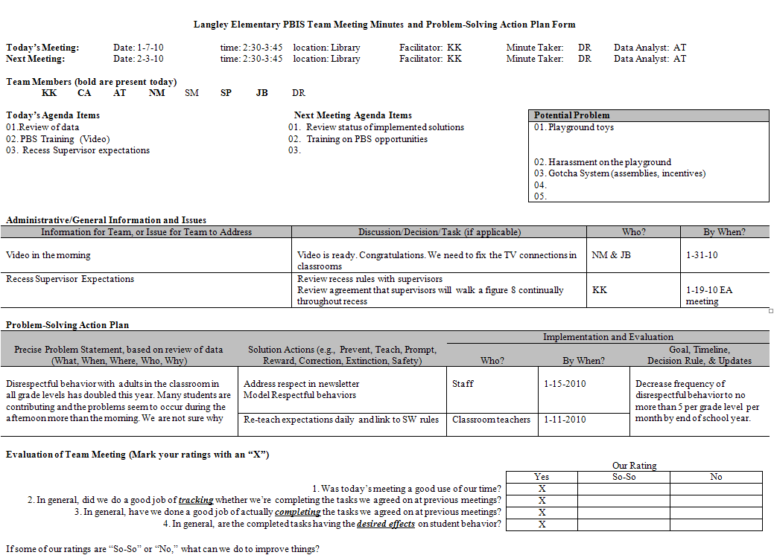
Notes:
A completed example…
If a person knows how to use the meeting minute form, the person should be able to pick these minutes up from Jan 7, 2010 and be able to organize previous items to update and facilitate creation of the Feb 3, 2010 agenda

Slide 42
Facilitation Tools and Resources www.papbs.org
Coaches Corner / Resources
  Big 5 Data Review Guide
  Meeting Minutes Form
  TIPS FINAL 9.30.10.ppt
  TIPS MTG Foundations Checklist.ppt
  Mult-Tiered Action Plan School year 10-11
  PA Evaluation Plan_FY 2010-11
Notes:
These are tools commonly used by coaches and may be found on the papbs website in the Resources section.
Trainers may add to or supplement this list at their discretion.

Slide 43
Effective Facilitation
Facilitator
Notes:
By way of reviewing the Facilitation Skills of a Coach…
Consider these questions…
Are you effectively facilitating monthly meetings with teams?
Reviewing the data?
Updating Action Plans when necessary?
Have a way to reach consensus on Action Plan items?
Have you been able to address behaviors of concern that happen both inside and outside of meetings? e.g., things like people who are gripers, whiners, those that are overly talkative, slackers – see resource “Meeting Monsters.”
Overall, do your PBIS team meetings run effeciively?

Slide 44
Self-Assessment of Coaching
Go to RtIIB/SWPBIS Coaches’ Training Worksheet. (Coaching 101 Handout)
Complete Self-Evaluation Section II: Items 1-6 before proceeding.

Slide 45
Overview RtIIB Coaching Content
Content/ Knowledge
Fluent in the Tier 1 RtIIB process
Knowledge of RtIIB principles
Knowledge of basic behavior principles
Behavior data system
Evaluation and data-driven decision-making
Resources
Notes:
We’re now moving into the area of Content and Knowledge.
As the Coach there are things you are going to want to be familiar in order to effectively facilitate your team through the process. We will go over each of these elements in detail.

Slide 46
1. Tier 1 RtIIB Process
Critical Elements
  - PBIS Team & Administrative Support
  Faculty Commitment, Participation
  Effective Discipline
  Data Entry & Analysis
  Expectations and Routines
  Acknowledgement / Recognition System
Lesson Plans for Teaching Behavior
Implementation Planning
Crisis Planning
Assessment, Progress Monitoring
Classroom PBIS Systems
Notes:
As the Coach you will need to be familiar with the Critical Elements for the Tier 1 RtII process for Behavior.
These elements were covered in the initial 3-day training that the Core Team went through. If you did not go through the training with your team , you will want to become familiar with this content and should seek support from your School-wide Facilitator for training or suggestions for how to become knowledgeable about this content.
You may also visit the PaTTAN website www.pattan.net under the RtII and Behavior links for resources.

Slide 47
2. RtIIB Principles
Core Principles
  Continual application of a structured problem-solving process
  Reliance on an integrated system to inform problem-solving
  Multi-tiered model of support that uses school resources efficiently
Notes:
You’ll also want to be familiar with the principles that are the foundation of RtII for Behavior.
The 3 core principles are…(see bullets). Elaborate for audience if needed.

Slide 48
3. Behavioral Knowledge
Antecedents
  event and/or stimulus that occurs before the behavior
Behavior
  the observable and measurable act
Consequences
  what occurs after the behavior that serves to maintain, increase, or decrease the frequency of behavior
Notes:
Although you don’t have to be a behavioral expert to be a PBIS Coach, you should have a basic knowledge of the principles of behavior.
We go over these as well in the initial 3 day training. Again see SWFs and/or PaTTAN resources for additional learning in this area.
One of the primary principles is that behavior is influenced by the environment and we must consider what happens before the behavior (antecedents) and what occurs after the behavior (consequences) to understand what may trigger and then maintain, increase, or decrease the behavior.
These are interrelated and we must consider all of these.

Slide 49
Only 2 Basic Functions of Behavior
  Functions of Behavior
Pos Reinf
Neg Reinf
Existing aversive condition identified
Notes:
Another basic principle is that all behavior has a function, i.e., put very simplistically, what is the individual attempting to gain or avoid?
The “thing” the behaviors are trying to get or get away from can be narrowed down to 3 categories: attention, tangibles, and sensory stimulation (too much./too little).
If these concepts are not familiar to you, this would be an indication to seek out more training or access the previously noted resources to build up behavioral knowledge .

Slide 50
4. Behavior Data System
District behavior database system
  i.e., SWIS/CICO…others?
Review and analyze data
  PBS Implementation Checklist
  Student outcome data (ODRs, ISS, OSS, Attendance)
  Staff Surveys
Run queries
Answer Questions
Notes:
It is also important to be familiar with the data system that is used by your school to document behavioral incidents.
The School-wide Information System (SWIS) is the web-based system designed to be used with Positive Behavioral Interventions and Supports.
Bullet 1: Ask what databases may be used in their school system.
Regardless of the system used, you need to be familiar with how to gather and review reports from the data system so the team has the information they need.
You also need to be familiar with the tools the Network provides for you to identify how well you are implementing and to move forward with a high level of implementation as well as for monitoring outcomes.
Staff surveys are also encouraged.
You need to run queries and be able to answer questions to conduct problem-solving analysis as a Team.

Slide 51
5. Evaluation and
Data-Driven Decision-Making
Realize the next few slides provide a brief introduction and overview section
Coaches will need more in-depth training for each Tool, i.e., a specific session on pbisassessment.org and each of the assessment tools
Notes:
Refer to State Evaluation Plan Handout and graphic that is the next slide…

Slide 52
Using Data
Measure | Pre | Year One |  |  |  | Year Two |  |  |  | Year Three
 |  | Fall | Winter | Spring | Summer | Fall | Winter | Spring | Summer | Fall | Winter | Spring | Summer
SAS¹ | X |  |  | X |  |  |  | X |  |  |  | X
PIC¹ |  | X | X |  |  | X | X |  |  | X | X
BoQ¹ |  |  |  | X |  |  |  | X |  |  |  | X
SET²
BAT⁴ |  |  |  |  |  |  |  |  |  |  |  | X
SSS¹ | X |  |  | X |  |  |  | X |  |  |  | X
ODR⁴ |  |  |  |  | X |  |  |  | X |  |  |  | X
PSSA³ | X |  |  |  | X |  |  |  | X |  |  |  | X
PVAAS³ | X |  |  |  | X |  |  |  | X |  |  |  | X
Safe Schools³ | X |  |  |  | X |  |  |  | X |  |  |  | X
School Profile⁴ | X |  |  |  | X |  |  |  | X |  |  |  | X
Data Collection Schedule
Notes regarding PAPBS evaluators’ access to data. ¹ = data completed via PBISAssessment website and automatically obtained by PAPBS evaluators via PBSEval.org secure website; ² = will be administered minimally once every three to five years, or more frequently based on need for additional data and/or recognition purposes; ³ = data obtained by PA PBS evaluators via public access; ⁴ = school must supply to PAPBS evaluators
Notes:
Provide Evaluation plan for SY2011-12 as a handout.

Slide 53
Evaluation Questions
Are we doing what we said we would do?
  PBS Implementation
  Implemented with fidelity
Is it working?
  Sustainability of implementation
  Benefits for students over time
  Benefits for staff
  Benefits to the community
Notes:
While the assessment structure may seem a bit complex, it all boils down to two basic questions…
The Project has designed tools to answer those questions.

Slide 54
Using Data
Identify areas that need improvement
  Improve Tier 1 supports
  Tier 2/ Supplemental
  Tier 3/Intensive
Support the acquisition of additional resources for further school improvement
Promote PBS within the community
Identify and celebrate successes
Notes:
You will be able to use the data that is identified, collected, and reported through the statewide evaluation plan to identify areas that need improvement. Those critical elements that your team could develop so you can have them most effective Tier 1 system possible. Also, to provide enhancements to Tier 2 and 3 level supports based on analysis of outcomes.
Data may also be used to provide documentation of need for additional resources.
It will also assist in promoting PBIS in the community. When positive outcomes are achieved promote the model by sharing and celebrating successes with all relevant stakeholders.

Slide 55
Evaluation Data
Work with School-wide Facilitator and principal to ensure data is submitted as requested
Refer to PA Evaluation Plan for Schedule
Beginning-Year Reports
  SET (if applicable)
    Conducted in Fall (Mid-October > November)
  Self-Assessment Survey and School Safety Survey
    For schools beginning to establish SWPBIS
Mid-year Reports
  PBS Implementation Checklist (PIC)
    Due Fall and Winter
End-Year Reports:
  BoQ and BAT (for schools implementing T2/3)
    Spring
  School Safety Survey & School Profile
    June 30
Notes:
SETs should not be conducted until at least six weeks after school has started.
- allows time for school to review and re-teach
- provides sufficient time for students to receive acknowledgement
This is a general reference. Refer to PA Evaluation Handout to clarify and use as graphic organizer.
The following slides are brief examples of current Tools used to collect, synthesize, and analyze data for problem-solving, progress monitoring (system) of implementation, and effectiveness of policies and strategies.
The following section is designed to acquaint Coaches with common Tools used in SWPBIS implementation by offering examples of data collected by schools in PA (except for the PIC).
This is not intended to be a substitution or replacement for in-depth training on assessment Tools.
Assessment Tools should be delivered as a separate module.
REMEMBER:
Data is used in support of changing the Social Culture through effective implementation of system supports and practices.
Data is not an end in itself!

Slide 56
PIC Chart
Provide graphic Organizer for PBS Implementation Checklist…
  Implementation Level Chart
    Explain it
Notes:
Following slides will address the PBS Implementation Checklist…

Slide 57
PIC Chart
PBS Implementation Checklist
  School Level Chart, Tier 1 Critical Elements
    Explain it
Notes:
Describe PIC…a brief progress monitoring tool for implementation elements of SWPBIS.
The PIC will provide core teams with data on the progress monitoring of implementation of critical elements of SWPBIS. It may be used 2 to 3 times per year.
It has Teams consider elements at all 3 Tiers!
Currently, the PIC is not yet available on www.pbisassessment.org, but it is likely to be included in the future.
Notice the similarities with items on the BoQ. If ratings on the PIC are high and accurate, then it is more likely a school will attain a 70 or greater on the BoQ.
The following examples are from Florida PBS Project. They have their own web-based system for this tool. It is not available nationally, yet.
Florida created the BoQ as an alternative to the SET. Now they have created the PIC as a progress monitoring tool for implementation. It should correlate highly with the BoQ.
Florida also created the Benchmarks of Advanced Tiers (BAT). The PIC provides a few critical elements that will correlate with Tier 2 and 3 implementation as measured by the BAT.
Note for future presentations: When PA begins to use the PIC, then insert data slides from PA schools.

Slide 58
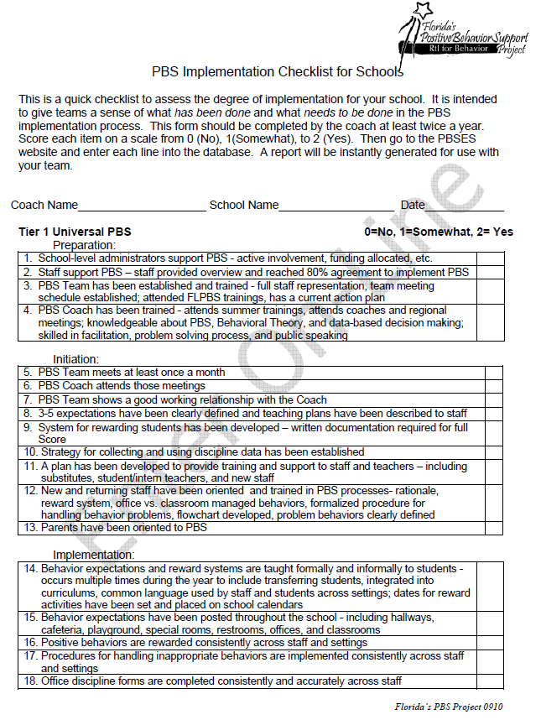
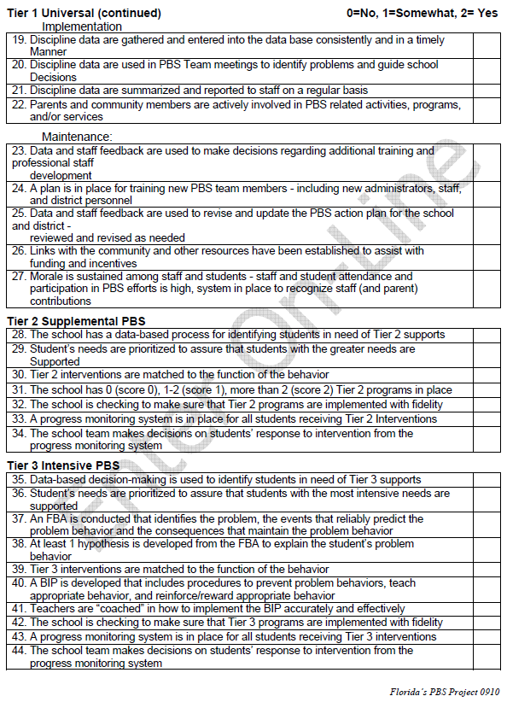
Notes:
This is what the PIC looks like in paper format. In Florida, a Team representative completes it online.
One may see that it is shorter and samples a few critical elements for implementation.
It covers all 3 tiers!
The BoQ and BAT are longer by comparison, but they offer more data and specifics about the implementation process and how effectively the staff have implemented the critical features of each Tier.

Slide 59
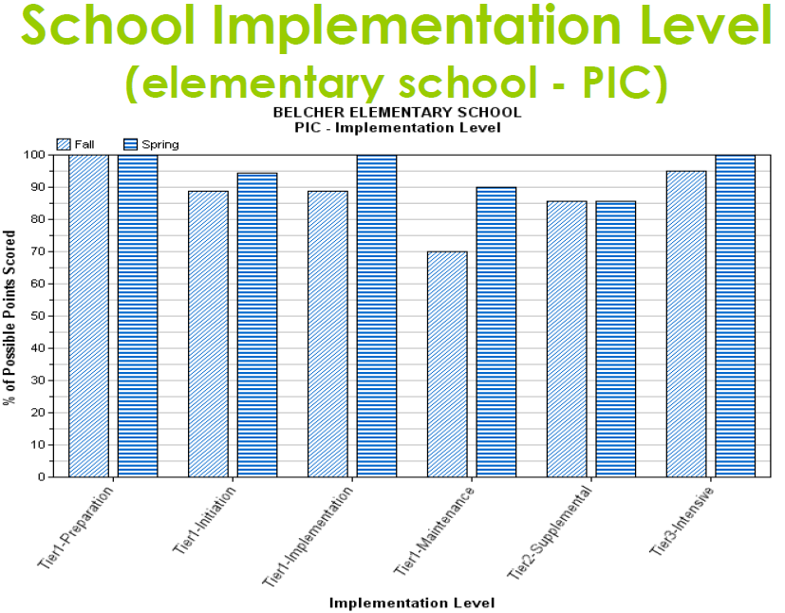
Notes:
Depicts Implementation Level across all 3 Tiers Fall > Spring.
Graphs are also available to measure Implementation Level of schools across the District – grouped by elementary level or high school level, for example.

Slide 60
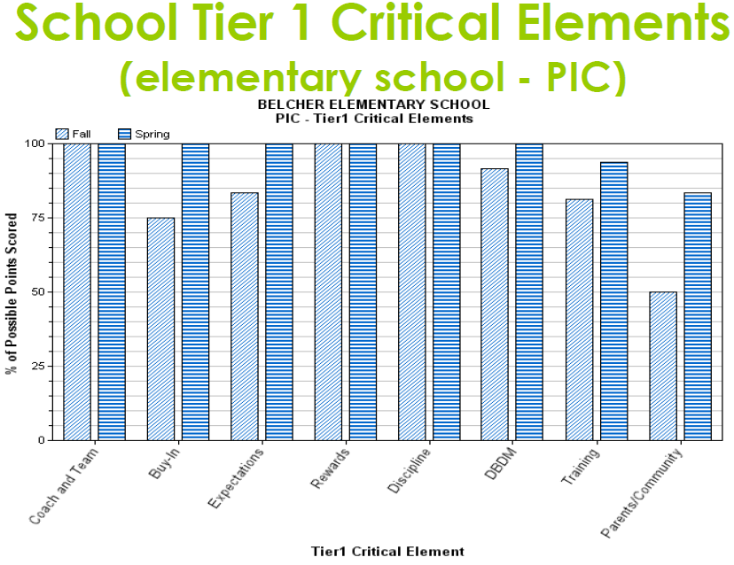
Notes:
This Chart shows Level of Implementation from Fall > Spring based on ratings of critical elements.

Slide 61
Benchmarks of Quality Chart
Provide Graphic Organizer of a Multi-year BoQ for a school in PA
    Explain it
Notes:
The following Chart will demonstrate how the Benchmarks of Quality may be used to analyze a school’s progress and effectiveness towards implementing the critical features of SWPBIS with Fidelity.

Slide 62
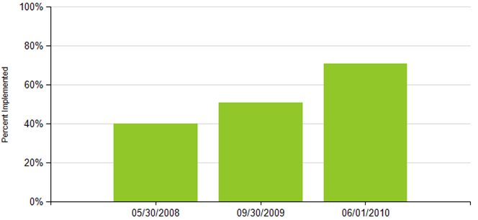
Multi-year
Benchmarks of Quality
Notes:
Multi-year Benchmarks of Quality shows progress over 3 years.
This Tool permits analysis of elements of SWPBIS as it relates to implementation of SW features @ Tier 1 with fidelity.
This is a good example of the progress made by a particular school.
It shows that implementation of SWPBIS may take time, but if a school perseveres and the administration, coach, and core team work together, the school will achieve implementation with Fidelity.
This school achieved 80+/80+ on the School-wide Evaluation Tool on its first assessment after reaching 70+ on the BoQ.
Soon schools will be able to use the PBS Implementation Checklist (PIC) during the school year to help them ascertain how well they are establishing Tier 1 features. It may be fairly predictive of how well a school will do on the BoQ.
Essential to accurate scoring is for the Team to rate their implementation practices honestly. If a Team rates themselves high based on the fact that they “think” they are implementing a feature well, an external review may not validate the rating. Always be prepared to provide evidence that a criteria was met.

Slide 63
Referrals Chart
SWIS Graphic of PA School data:
  Total Referrals per 100 Students / Multi-year
    Explain it
Notes:
Next Chart demonstrates the use of SWIS and data analysis based on Total number of referrals for a school population.

Slide 64
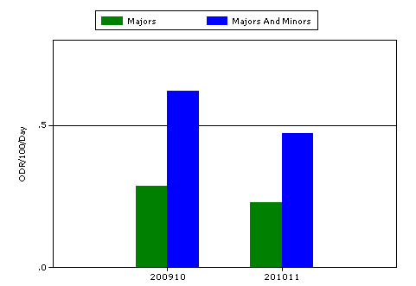
Total Office Referrals Per Day/Per 100 Students
School Year | Majors | Majors & Minors
2009-10 | .29 | .62
2010-11 | .23 | .47
Notes:
Elementary School
09-10 Enrollment – 865
10-11 Enrollment – 835
Here we see a reduction of around 21% Major Discipline referrals from the 2009-10 school year to the 2010-11 school year. This is based on the number of discipline referrals per day for every 100 students.
For the same period, when on looks at the difference between Majors and Minors, combined, there was a reduction of approximately 24%.
So, by using SWIS data a school may monitor and determine effectiveness of PBIS policies and practices as they implement them.

Slide 65
OSS per 100 Students
SWIS Graphic of PA School data:
  Total Days Suspension per 100 Students / Multi-year
    Explain it

Slide 66
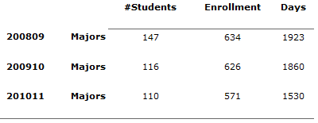
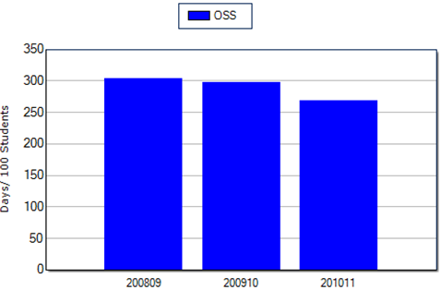
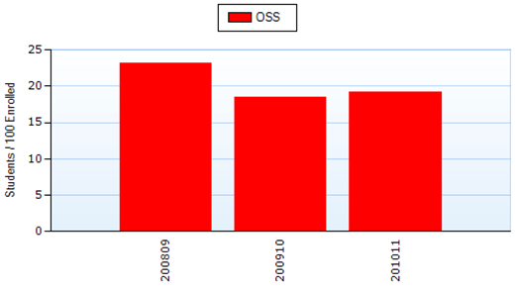
OSS per 100 Students
23.1
23
303
297
18.5
19.2
268
Notes:
This Chart is a multi-year histogram of Out-of-School Suspension data for a secondary school.
The “number/100 students” ratio is used to account for fluctuations in population and by showing the number per 100 students allows better comparison between years or between schools. One is not comparing the raw numbers without accounting for school context.
The Red OSS graph depicts the number of students per 100 that received OSS.
This is an interesting example because student enrollment went down each year as did the number of students receiving Majors accounting for OSS. Thus, we see a decrease in the number of majors from SY 2008-09 to 2009-10. There is a slight increase in OSS per 100 in SY 2010-11. Still, from the first year to the third year there was a 17% reduction in the number of OSS compared to enrollment.
The Blue OSS graph shows the number of days of OSS served per 100 students. The third year demonstrates a 12% reduction in the number of days compared with the first year.
So, in this case, even though the number of OSS went up in the third year (i.e., for every 100 students), the number of days per 100 students decreased by approximately 10% from the previous year.
REMEMBER:
The data is shows “what” happened. It does not show “why.” it is up to the Team analyzing the data to come up with plausible explanations or hypotheses for the change in the data.

Slide 67
Oregon School Safety Survey Results
Graphic of PA School data:
  School Safety Survey
    Explain it
Notes:
The Oregon SSS provides core team, administration, and staff with data to analyze regarding strengths and needs for students around the issues of risk and protective factors.
This relates to the implementation of SWPBIS because schools implementing with fidelity should, overtime, see decreases in Risk Factors and increases in Protective Factors.
It may provide some information to consider regarding the extent to which there is a positive culture and/or climate within a building. Relates to school safety perceptions, however, this is NOT a measure of school culture or school climate.

Slide 68
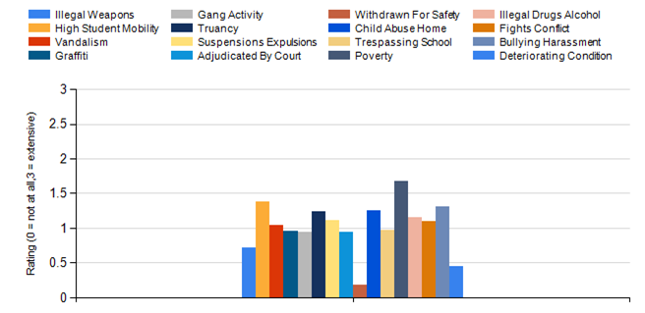
School Safety Survey Results
School Year: 2010-11
Risk Factors
Notes:
This is not a multi-year chart; it is a single year chart.
This chart depicts how the teachers perceived each factor as a “risk” for students within the school.
None were exceptionally high, but the 3 highest were in descending order: 1) Poverty; 2) High Student Mobility; 3) Bullying Harassment.
It is up to the core team and staff to discuss the implications for whether a problem exists and what factors may be possibly targeted and prioritized for problem-solving.

Slide 69
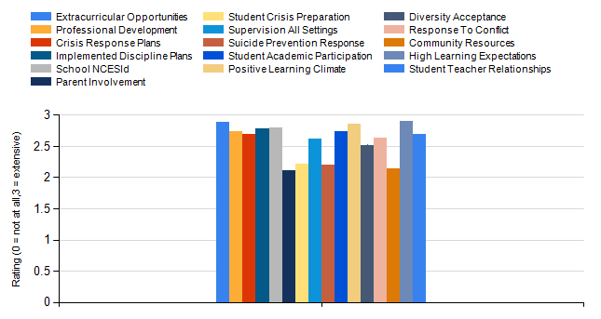
Oregon School Safety Survey Results
Protective Factors
School Year: 2010-11
Notes:
As a corollary to the previous slide, this shows the staff perceptions about the existence of protective factors.
Here a comparison of “highs” and “lows” may stimulate conversation and problem-solving with respect to areas that may be enhanced…and celebrate the “highs”.
Risk and Protective Factors should be monitored over time to ensure improvements are being sustained and to proactively address issues that staff see as potentially problematic.
As always, share information with staff and celebrate the achievements!
In Pennsylvania, the expectation is that as many staff as possible take the Oregon School Safety Survey.

Slide 70
6. Content Resources
Websites
  Pennsylvania Positive Behavior Support Network
    www.papbs.org
  National Technical Assistance Center for Positive Behavioral Interventions and Supports
    www.pbis.org
  Association for Positive Behavior Support
    www.apbs.org
  Pennsylvania Training and Technical Assistance Network
    www.pattan.net (see Behavior and RtII Initiative links)
Staff
  District Coordinator
  Other Coaches (networking meetings)
  School-wide Facilitator
  Regional Facilitator
  State Coordination Team
Notes:
In summary, we have reviewed some of elements of content knowledge that a Coach needs to master in order to support the implementation of SWPBIS.
It is a complex but doable process and a wealth of resources are available to assist the Coach in his/her professional development.
National and State websites provide numerous examples, strategies, and methods to help facilitate and problem-solve with your Team.
Personal assistance and guidance may be accessed through District, Regional, and State SWPBIS Facilitators and Coordinators.
Please do not hesitate to seek out and use these resources.

Slide 71
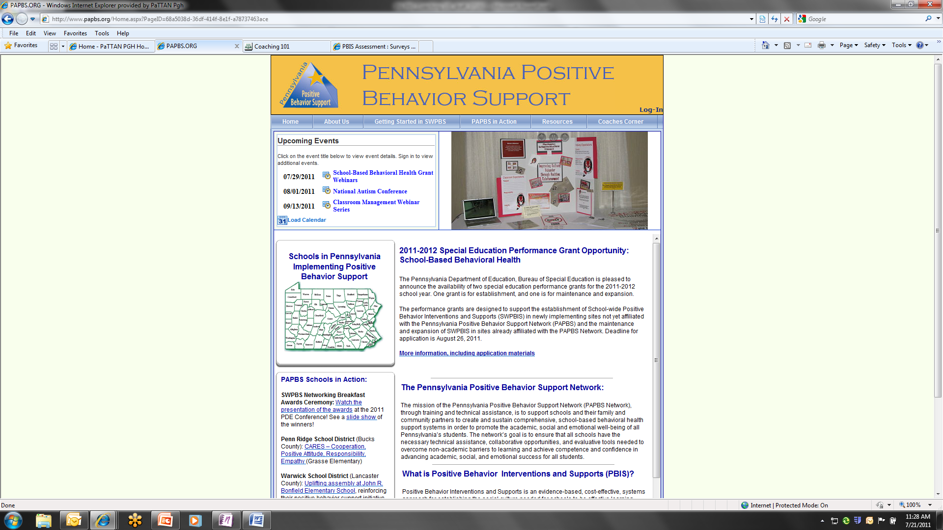
Notes:
Points out Coaches Corner on website.

Slide 72
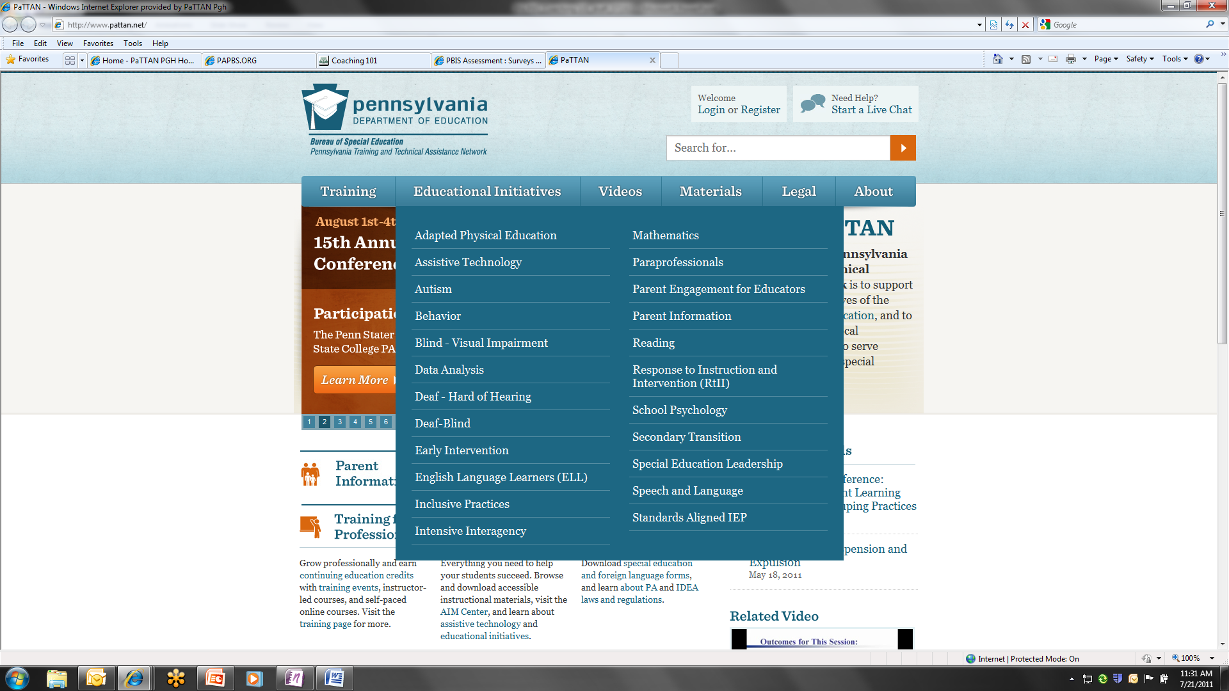
Notes:
Points out Behavior relevant links on PaTTAN website.

Slide 73
Coaching Function - Content
Content/Knowledge
As the PBS Coach:
Do you have sufficient knowledge regarding
  The processes and procedures of school-wide PBS?
  The core principles of RtII:B?
  Basic behavioral principles?
Identify 3 resources found on Pennsylvania’s PBS website?
Identify 2 additional resources to assist you in carrying out your responsibilities as a PBIS Coach?
Identify / share resources that you are aware of that were not covered in this training.
Notes:
This slide may be used as an activity…
For example: Round-robin report of knowledge
Web search for resources – report out
Pair-share resources – report out

Slide 74
Self-Assessment of Coaching
Go to your RtIIB/SWPBIS Coaches’ Training Worksheet. Complete Self-Evaluation
Section II: Items 7-12 before proceeding
Notes:
Complete items activity

Slide 75
Coach as Communicator
Communicator
Communicate progress of RtIIB process
Conduct faculty training
Schedule effective communication
Utilize communication tools
Notes:
Final function of a Coach is that of Communicator.
We are going to break that down into 4 general areas:
- Review 4 bullets.

Slide 76
1. Communicate Progress
Positively reports, promotes, shapes and reinforces team progress
Effectively communicates PBS data, progress, and successes through regular presentations
  School leadership
  District coordinator and staff
  Parents
  Community
Notes:
Regularly communicating progress of your team promotes and shapes and reinforces the team as you go forward.
Sharing with other people, recognizing the achievements can help promote and build up the team as well as help others outside the team understand what is going on.
You can actively communicate the data, the progress your team is making through regular presentations such a s leadership sessions, district level meetings, parent groups, and community gatherings.

Slide 77
2. Conduct Trainings
Conduct faculty trainings
  PBS:RtIIB
  Behavior principles
  Problem-solving process (TIPS)
Notes:
Even if one does not train on TIPS, for example, a Coach should understand and assist the team to use this problem-solving model and, perhaps, co-train with a coordinator or School-wide Facilitator on these and other relevant topics to implementation.
Another part of communicating is communicating the ideas, procedures, and processes that your Team is helping to make possible.
You will be conducting faculty training, not necessarily on your own but as a team or even incorporating other people beyond the immediate team to help faculty understand the principles and process, components and elements as you implement them. They will also learn the underlying principles of behavior and help them learn the problem solving process that the Team is using but that all faculty need to understand and be able to participate in.

Slide 78
3. Schedule Effective Communication
Monthly
  Encourage the PBIS team to meet
  Ensure data are summarized in useful format
  Facilitate team meeting using TIPS approach and the Minutes/Action Plan Form
  Give data-based updates to faculty
  Attend Coaches Networking meetings facilitated by School-wide Facilitator
Bi-weekly (or, weekly)
  Prompt team members to complete tasks
  Ensure your tasks are completed in a timely fashion (model behavior)
Daily
  PBIS’ Ambassador (look for opportunities to share info with others, etc.)
  Model positive interactions and reinforcement with staff and students
Notes:
Effective Communication doesn’t just happen, you need to be intentional about it.
Scheduling times can make sure you don’t drop the ball, and have things fall between the cracks.
Monthly, of course, have team meetings with great communication there. Have data summarized to be used efficiently. Ensure good communication by using the Action Plan and share outcomes with Faculty.
Attend Networking Meetings to share and learn with PBIS colleagues.
Model PBIS interactions on a daily basis and encourage staff and students to do the same.

Slide 79
4. Utilize Communication Tools
Tools
  PAPBS Network’s PBIS State Newsletter
  School Newsletter
    Success stories (teachers, students, events)
  Data, cost/benefit chart
  Faculty, parent and student presentations
    Videos, skits, bulletin boards
  School events
    Ballgame, concert, assemblies, etc.
  School Board presentations
Notes:
What are some of the Tools you have available to facilitate effective communication?
Newsletters…
Data…
Presentations…for faculty, parents, and students
Events…
School Board presentations to inform and apprise them of positive outcomes and successes – also supports requests future requests for resource allocation.

Slide 80
Coaching Function:
Communication
Communicator
As the PBIS Coach
How will you share PBIS and behavioral concepts with team members?
Have you established a process for sharing information with your faculty?
  Critical elements of PBIS and school-wide practices?
  Classroom PBIS?
How will you share PBIS implementation data with the District?
How will you share PBIS Content and success with the community?
Notes:
Because this is C101, it may be helpful to do this as an activity.
By way of summarizing, how will you share this information as a Coach…
Pair-Share-Report
Also, may want to have experienced Coach or two available to describe what they do and how they do it.
Could be discussion point for Networking meetings as well.

Slide 81
Self-Assessment of Coaching
Go to your RtIIb/SWPBIS Coaches’ Training Worksheet. Complete Self-Evaluation
Section II: Items 13-16 before proceeding
Notes:
Complete items activity

Slide 82
How am I doing?
And
What do I need?
Notes:
We’ve covered a lot of information in this session. So, how are you doing? What do you need?

Slide 83
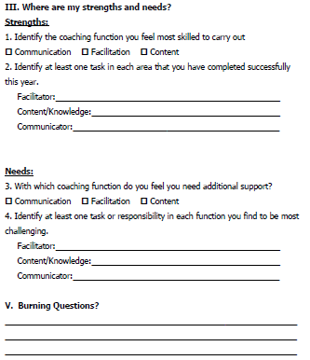
My Skills as a PBIS Coach
RtIIB/SWPBIS Coaches Training Worksheet
Section III
Notes:
Complete Section III. Identify your strengths and needs.
Provide time for them to complete this…

Slide 84
Additional Resources and Trainings
Kansas training modules
  http://www.pbskansas.org/htdocs/external_links/default.html#onlinetrainingmodules
Online Academy
  http://elearndesign.org/resources.html
PBIS Missouri
  www.pbismissouri.org
University of Connecticut
  http://cberuconn.edu/resources/training
University of Oregon Training Manual
  http://pbismanual.uoecs.org/manual.htm
Notes:
Some additional trainings and resources available on the web.
These are great resources!

Slide 85
Questions?

Slide 86
School-wide Facilitator sfacilitator@email.net
(Your name) (Your email)
Contact Information and Resources
OSEP TA Center on PBIS
www.pbis.org
Agency website
Phone
E-mail
Fax
Notes:
When you conduct trainings, insert your name and email as the person to be contacted for additional assistance and support.
You may also want to list your agency and other pertinent contact information.

